Slide 1

FORBIO
Fostering sustainable feedstock production for advanced biofuels on underutilised land in Europe
Workshop - The contribution of FORBIO project to the sustainable development of bioenergy
27 November 2018
Rome, Italy
Cosette Khawaja, Rainer Janssen
WIP Renewable Energies
Sylvensteinstr. 2
81369 Munich
www.wip-munich.de

Slide 2
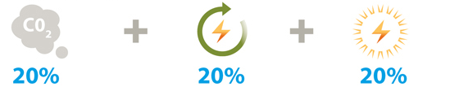
Background
Greenhouse gas levels
Energy consumption
Renewables in energy mix
EU 2020 targets compared to 1990
40%
27%
27%
EU 2030 Targets compared to 1990
3.5% Advanced biofuels in transport
RED II 2030
=> More bioenergy needed

Slide 3

Background
But, Bioenergy may compete with food / feed production
Underutilised land offer an alternative to produce sustainable bioenergy without competing with food / feed
FORBIO demonstarted the viability of using these lands for sustainable bioenergy production

Slide 4
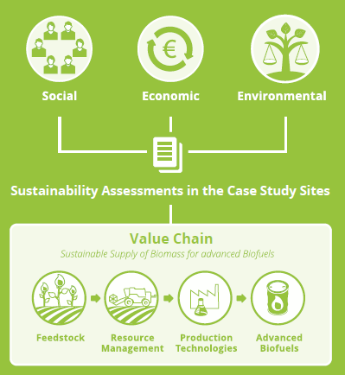
FORBIO objectives
Identify social, economic, environmental and governance-related opportunities and challenges
Evaluate agronomic and techno-economic potential of the selected bioenergy value chains
Assess environmental, social and economic sustainability
Analyse economic and non-economic barriers to the market uptake
Encourage European farmers to produce sustainable biomass feedstock
Build capacity of stakeholders for setting up sustainable bioenergy supply chains

Slide 5


Profile
Project duration: January 2016 – December 2018
Funded by the EU H2020 under the call H2020-LCE-2015-3
Estimated project cost: 1,941,581 €
Coordinator: WIP Renewable Energies & GEONARDO

Slide 6












Project Consortium
WIP Renewable Energies
Contact: Rainer Janssen, Cosette Khawaja, Dominik Rutz
Scientific Engineering Centre “Biomass“ Ltd
Contact: Oleksandra Triyboi
Food and Agriculture Organisation of the United Nations
Contact: Marco Colangeli, Lorenzo Taverno
Center for Promotion of Clean and Efficient Energy
Contact: Nicoleta Ion
Geonardo Environmental Technologies Ltd.
Contact: Ömer Ceylan, Peter Gyuris, Attila Udersky
Forschungsinstitut für Bergbaufolgelandschaften e.V.
Contact: Dirk Knoche, Raul Köhler
Consiglio per la Ricerca in Agricoltura e l‘Analisi dell‘Economia Agraria
Contact: Guido Bonati
Polish Biomass Association
Contact: Maria Smietanka, Magdalena Rogulska
Biochemtex Spa
Contact: Stefania Pescarolo
European Landowners‘ Organization
Contact: Marie-Alice Budniok
Blacksmith Initiative - UK
Contact: Valeriia Kovach
University of Limerick
Contact: JJ Lehay

Slide 7
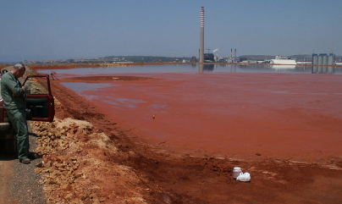
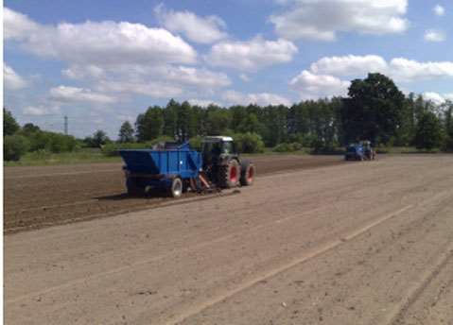
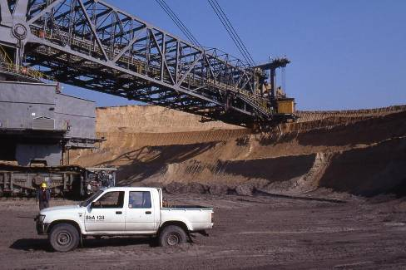
Case studies
CASE 1
ITALY
Sulcis, Portoscuso
Contaminated land from
industrial activities
22,000 ha
CASE 2
UKRAINE
Kyiv oblast, Ivankiv region
Underutilised marginal agricultural land
Over 20,000 ha
CASE 3
GERMANY
Metropolis region
Berlin & Brandenburg
Sewage irrigation fields & lignite mining
1,140-3,917 ha and 7,295-11,795 ha
Agronomic and technoeconomic feasibility studies of the case studies
Potential value chains of bioenergy production on underutilised land
Sustainability assessment of the most promising value chains

Slide 8
Knowledge transfer & Capacity building
Country |  | Info days |  | Capacity building
 |  | In target region | In another region | First event | Second event
Target countries | Italy | 13-14 October 2016, Carbonia, Sardinia | 20 June 2018, Rome | 7 June 2018, Cagliari, Sardinia | 19 September 2018, Ferrara
 | Ukraine | 12 December 2017, Kiev | 16 May 2018, Cherkasy | 21 February 2018, Kiev | 17 May 2018, Cherkasy
 | Germany | 6 September 2017, Finterwalde | 27 June 2018, Potsdam | 7 April 2018, Goßmar | 12 June 2018, Neuperhain
Outreach countries | Belgium |  |  | 22 May 2018, Westmalle | 28 July 2018, Libramont
 | Poland |  |  | 24 May 2018, Warsaw | 04 September 2018, Płońsk
 | Romania |  |  | 18 July 2018, Bacau | 31 August 2018, Targoviste
 | Hungary |  |  | 6-7 June 2018, Gödöllő
 | United Kingdom |  |  | 6-7 June 2018, Lincoln
Notes:
The main objective of the information days in the target regions is to put together landowners, farmers, local actors and biomass supply chain stakeholders with the aim of encouraging them to initiate the setting up of sustainable local bioenergy supply chains on underutilised land.

Slide 9
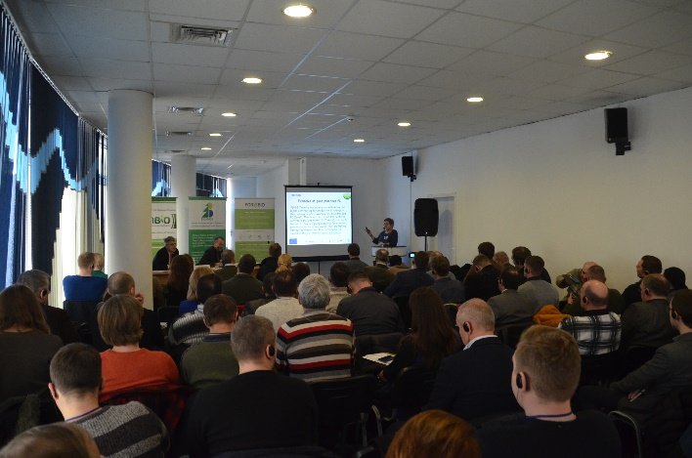
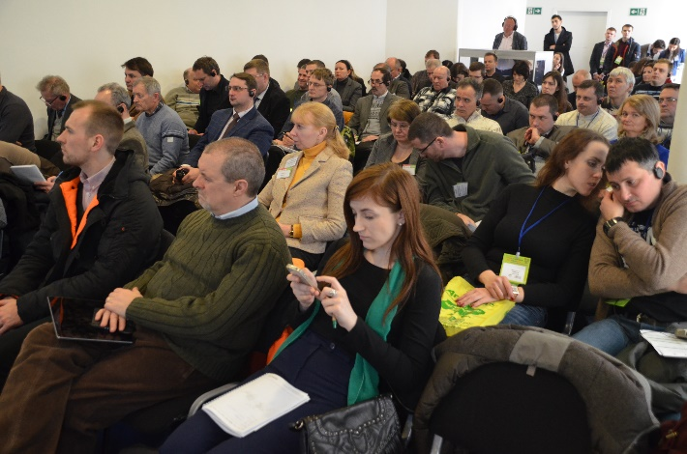
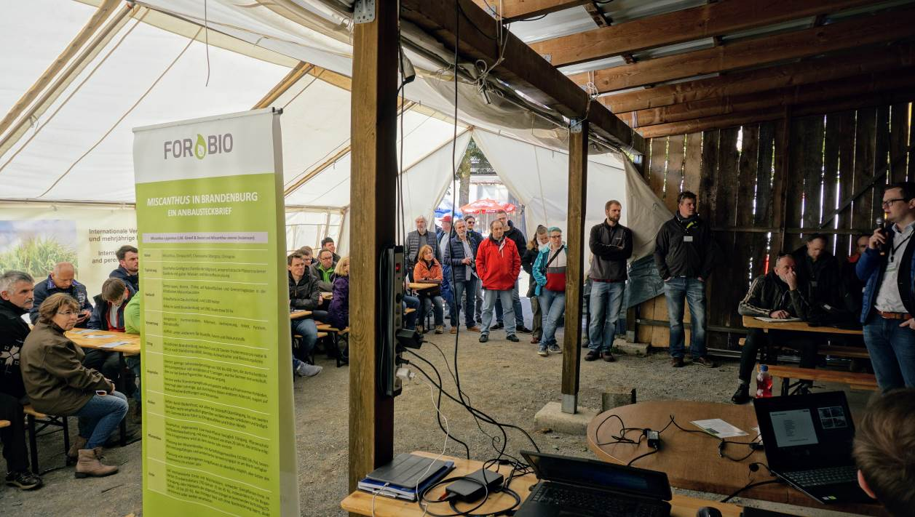
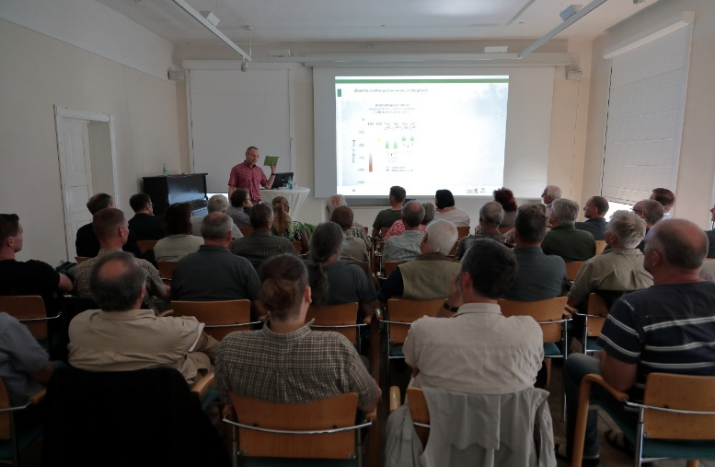
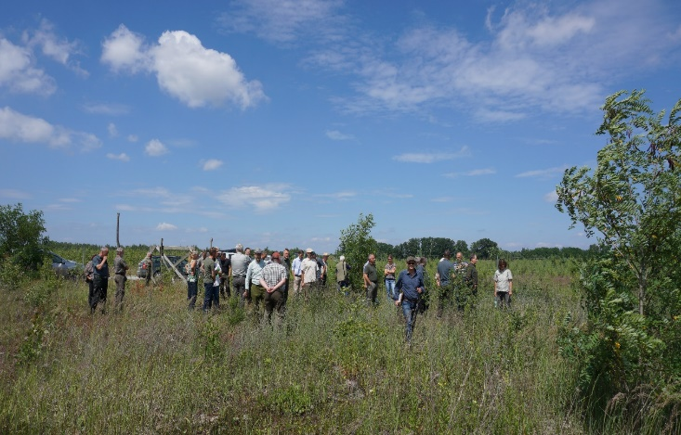

Slide 10
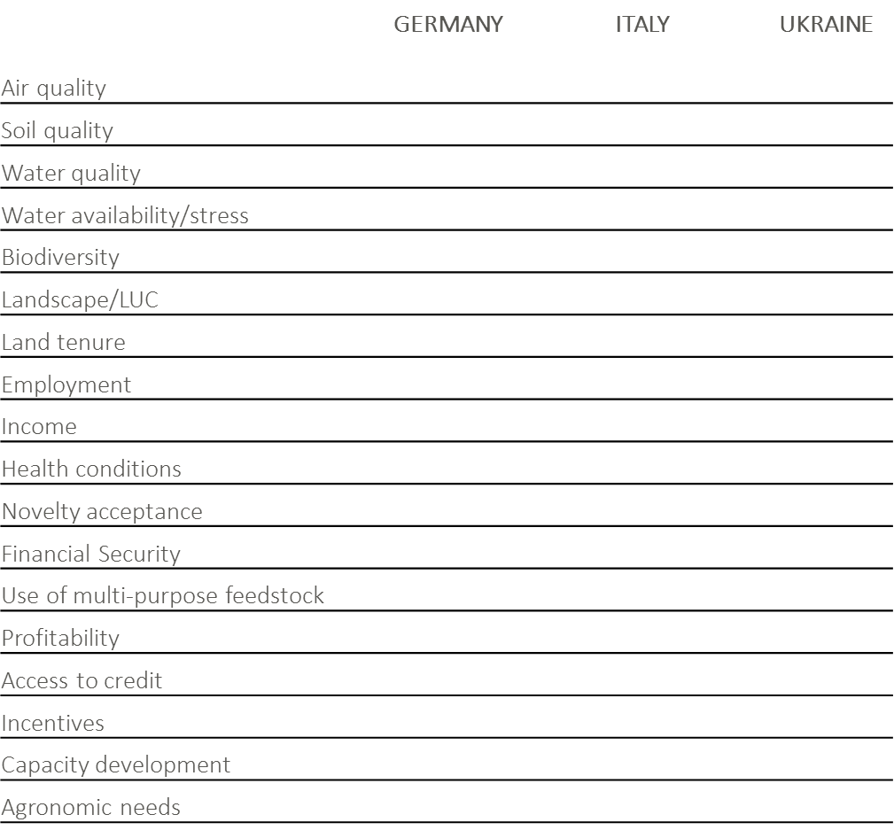
Barriers

Slide 11
Thank you for your attention!
Cosette Khawaja, Rainer Janssen
cosette.Khawaja@wip-munich.de
rainer.Janssen@wip-munich.de
WIP Renewable Energies
Sylvensteinstr. 2
81369 Munich
www.wip-munich.de
www.forbio-project.eu

