Slide 1
WP1 Management
26 November 2018
Rome, Italy
Rainer Janssen, Cosette Khawaja
WIP Renewable Energies
Sylvensteinstr. 2
81369 Munich
www.wip-munich.de
Ömer Ceylan, Peter Gyuris
GEONARDO
Zahony utca 7
H-1031 Budapest
www.geonardo.com

Slide 2
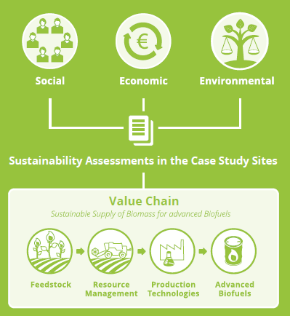
Project idea
Assess the viability of using underutilised land (contaminated, abandoned, marginal, fallow land etc.) for sustainable bioenergy feedstock production
Develop a strategy for building up competetive and sustainable local supply chains
No effect on the supply of food and feed
No interference with land used for recreational and conservation purposes

Slide 3
Project Consortium
WIP Renewable Energies Contact: Rainer Janssen, Cosette Khawaja, Dominik Rutz
Scientific Engineering Centre “Biomass“ Ltd Contact: Oleksandra Triyboi
Food and Agriculture Organisation of the United Nations Contact: Marco Colangeli, Lorenzo Taverno
Center for Promotion of Clean and Efficient Energy Contact: Nicoleta Ion
Geonardo Environmental Technologies Ltd. Contact: Ömer Ceylan, Peter Gyuris, Attila Udersky
Forschungsinstitut für Bergbaufolgelandschaften e.V.
Contact: Dirk Knoche, Raul Köhler
Consiglio per la Ricerca in Agricoltura e l‘Analisi dell‘Economia Agraria Contact: Guido Bonati
Polish Biomass Association Contact: Maria Smietanka, Magdalena Rogulska
Biochemtex Spa Contact: Stefania Pescarolo
European Landowners‘ Organization Contact: Marie-Alice Budniok
Blacksmith Initiative - UK Contact: Valeriia Kovach
University of Limerick Contact: JJ Lehay

Slide 4
Overall project coordination
WP-Leaders are responsible for coordinating the progress in WPs
Interim Report was submitted on 28th August and accepted after the resubmission
Interim payment was transferred to the consortium partners
Final report will be submitted before 28 February 2019
Final payment will be transferred after acceptance of the report.

Slide 5
Problems
BIOCHEMTEX Status
University of Limerick Status

Slide 6
Review meeting
The meeting took place on 28th September in Brussels at ELO’s offices
WIP, GEO, FAO, Biochemtex, CREA, 2 representatives from INEA and 1 representative from DG Research attended the meeting
The interim technical report and financial report were re-submitted as some details had to be added after the review meeting
The final review meeting will take place on 21 February in Brussels
(Place: ELO’s offices?)

Slide 7
Communication with the EC
Project officer at INEA – Mrs. Olja Kristic
WIP makes all communication to INEA
No direct communication between INEA and partners
Coordinators meeting took place on 18th January 2018 in Brussels

Slide 8
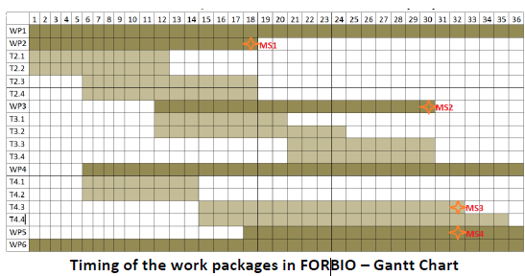
Work Packages
Management - WIP/GEO
Feasibility - CTXI
Sustainability - FAO
Barriers - FAO
Knowledge transfer - WIP
Diss.&Exploitation - GEO
WP 2 - Feasibility – ended in June 2017
WP 3 - Sustainability – started in January 2017
WP 4 - Barriers - started in June 2016
WP 5 - Knowledge transfer – started in June 2017

Slide 9
Deliverables
Each partner is responsible for his own deliverables
Responsibility of joint deliverables is within the authors
WP-leaders shall make the first review of the deliverables
GEO and WIP will make the final review
WIP will upload deliverables on the system
Deliverables shall be uploaded to the Participant portal
http://ec.europa.eu/research/participants/portal/desktop/en/home.html

Slide 10
Status of deliverables in ECAS system
Not submitted
Submitted, not approved

Slide 11
Status on deliverables
Deliverable 6.5 - Data Management Plan
PO asked to update it
“Although not foreseen in the DoA, the consortium is advised to update the communication and dissemination plan and the data management plan It is also recommended to include multiple language option on the project website”.
Attila sent an e-mail on 20.09.2018 for possible comments or updates from partners. Status?

Slide 12
Reporting
Report 1: Interim Report (technical and financial report)
- reporting period (month 1-18; 01.01. 2016 – 30.06.2017)
- submitted on 28th August 2017; resubmitted in November 2017; accepted in December
Report 2: Final Report (technical and financial report)
- reporting period (month 18-36; 30.06.2017-31.12.2018)
- the coordinator must submit a periodic report within 60 days following the end of each reporting period (28 February 2019)
WIP will inform partners regularly about final reporting, financial issues, etc.
Check the presentation of Christine on financial issues at the Kick-off-Meeting
Template for time recording was provided by WIP

Slide 13
Ethical mentor
Mr. Sasha Kuhrau – expert on data protection and security
INEA approved
Budget is reserved to support the services of the Ethics mentor
No specific data protection and security issues were detected in Months 1-18 (interim reporting period)

Slide 14
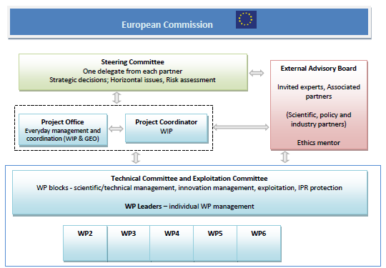
Advisory board
1-2 delegates per country
WIP sent a table
Official invitation letter
Communication: e-mail, phone

Slide 15
Steering committee
Representatives – one from each partner
SC meetings are an integral part of the project meetings
Dedicated SC meetings only „on demand“
SC meeting after the project meeting, additional 30 min. - optional

Slide 16
Project meetings
Kick off meeting, 14-15th January 2016, Budapest, Hungary
1st Progress meeting, 12th October 2016, Sardinia, Italy
2nd Progress meeting, 10-11th April 2017, Munich, Germany
3rd Progress meeting, 5th September 2017, Finsterwalde, Germany
4th Progress meeting, 20 February 2018, Kiev, Ukraine
Final project meeting and final workshop in Rome

Slide 17
Thank you for your attention!
Rainer Janssen, Cosette Khawaja
WIP Renewable Energies
Sylvensteinstr. 2
81369 Munich
www.wip-munich.de
Ömer Ceylan, Peter Gyuris
GEONARDO
Zahony utca 7
H-1031 Budapest
www.geonardo.com
http://www.forbio-project.eu

