Slide 1
Italian case study: Agronomic and Techno-economic feasibility
Guido Bonati – Giuseppe Pulighe
Rome - 27 November 2018 – FAO Headquarters

Slide 2
OUTLINE
Location of the Italian case study
Agronomic feasibility of bioenergy crops
GIS-based evaluation of suitable lands
Techno-economic feasibility
Results and conclusions

Slide 3
Italian case study
The case study is located in the Sulcis area in the South–west Sardinia, Italy (Mediterranean semi-arid climate)
Located in the largest Contaminated Sites of National Interest (SIN) in Italy (about 22,000 ha), polluted by industrial ﬂumes derived from coal power generation, bauxite and aluminum production, and previous mining activities
High levels of heavy metals in the topsoil (mainly Pb, Cu, Cd, Co and Zn)

Slide 4
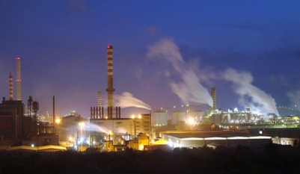
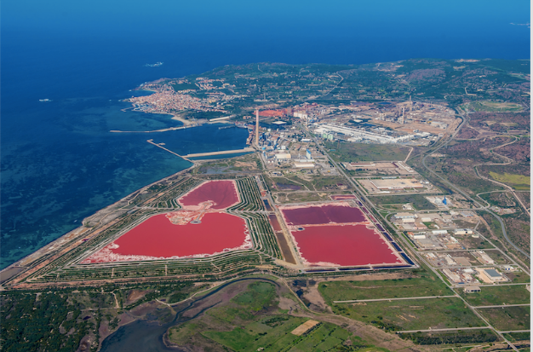
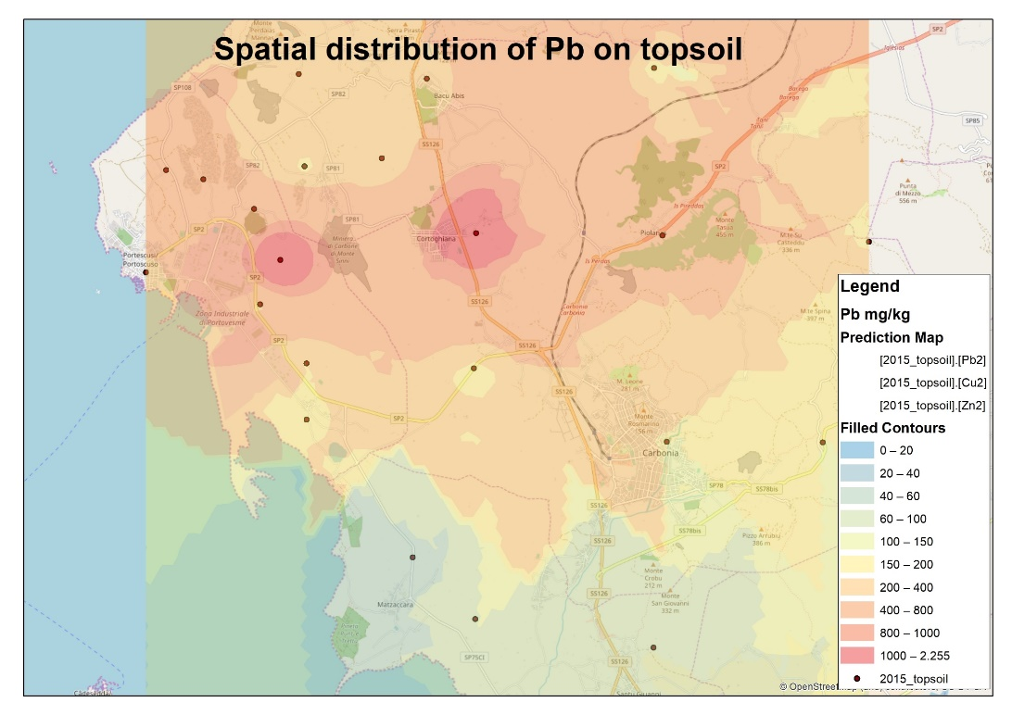
Industrial area of Portovesme
Topsoil analysis, year 2015
Site “Perdaias”: Pb 2673 mg/kg - Zn 8475 mg/kg
Site “Cortoghiana”: Pb 1881 mg/kg - Zn 8926 mg/kg
Site “Norman”: Pb 2210 mg/kg - Zn 5114 mg/kg
The Italian law (D.Lgs. 152/06 (Annex 5)) sets as limit value for Pb 100 mg/kg on public spaces and residential areas, 1000 mg/kg on commercial and industrial areas. For Zn 150 mg/kg and 1500 mg/kg respectively.

Slide 5
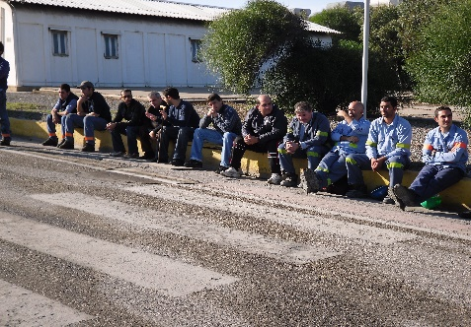
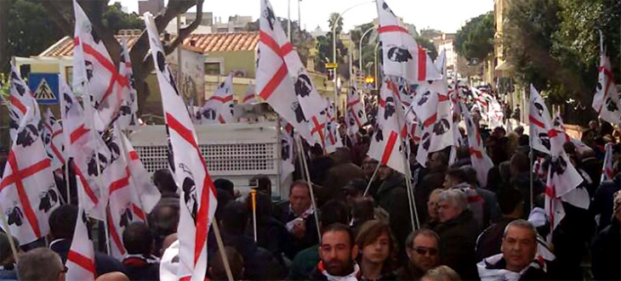
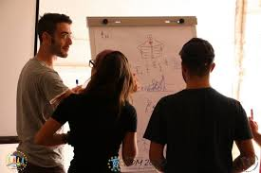
Opportunities for the study area
High unemployement in the Sulcis area:
Creates job opportunities (biorefinery supply chain > energy, fuels, chemicals or bio-base materials)
Underutilized (economic marginal) land:
New opportunities and diversification for farmers on the local level (an opportunity to use natural resources (bioeconomy) in a sustainable way)
Contaminated soils:
Phytoremediation of heavy metal-contaminated soils using perennial energy crops (….. in the future, requires protocols)

Slide 6
Challenges
Reliable data on best suited crops for underutilized lands
Areas potentially suitable for biomass production
Little awareness regarding the advantages of using underutilized land for Renewable Energy Sector (RES)
Lack of local strategies regarding RES development and valorization of underutilized lands

Slide 7
Provide a knowledge base for no-food supply chains in the Sulcis area
Agronomic feasibility
Investigate the feasibility of no-food crops for land restoration and alternative systems of bioenergy production for European replicability

Slide 8
Feedstock identification Which crops?
Agronomic Feasibility

Slide 9
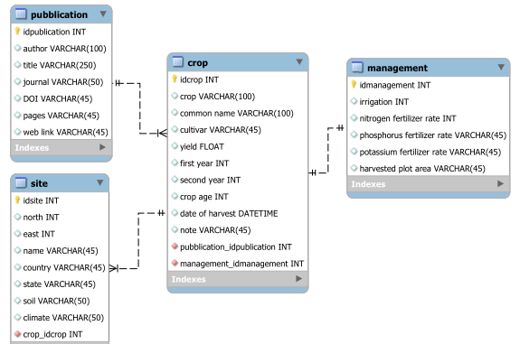
Agronomic feasibility
Analysis of field trials and scientific studies (Meta-analysis) on (bioenergy) crops conducted in Sardinia (various environmental conditions, characterized by different soil and climate characteristics)
Cultivation protocols, crop inputs (N, P, K, water), pedologic data, biomass yield
Output: Short list of most promising bioenergy crops
Data implemented in a MySQL relational batadase
Notes:
All relevant data extracted and examined were implemented in a relational database implemented in MySQL.

Slide 10
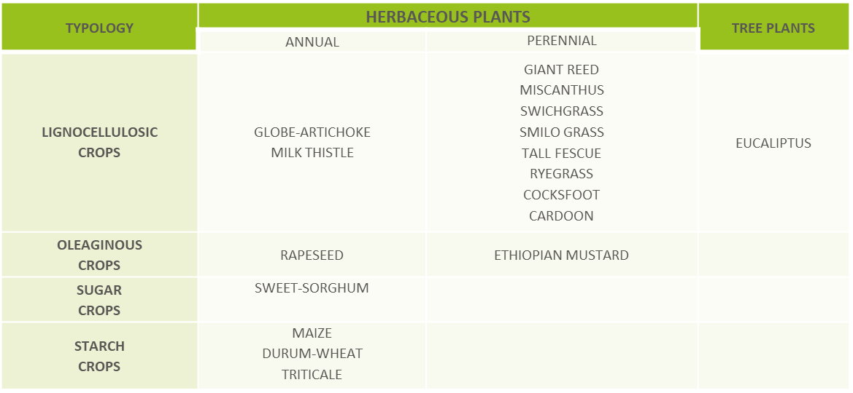
Overview of agronomic characteristics of perennial biomass crops inventoried in Sardinia.
Identified 17 different crop species
The database includes 451 observations from 19 different locations
Notes:
This table is an example of biomass crops inventoried.

Slide 11
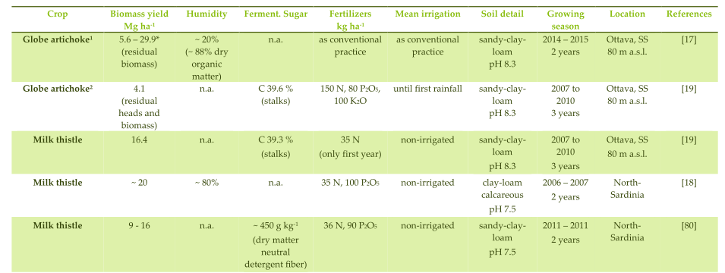
Agronomic feasibility
Overview of the agronomic characteristics of some annual crops
Notes:
This table is an example of the parameters collected in the literature review.

Slide 12
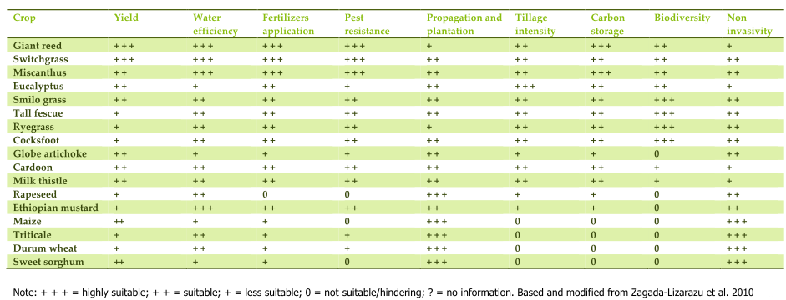
Agronomic feasibility
Qualitative matrix of the main agronomic characteristics and impact on the ecosystem services/services of the inventoried crops
Zegada-Lizarazu, W.; Elbersen, H. W.; Cosentino, S. L.; Zatta, A.; Alexopoulou, E.; Monti, A. (2010) - Agronomic aspects of future energy crops in Europe. Biofuels, Bioprod. Biorefining, 4, 674–691.

Slide 13
Agronomic feasibility
Box-plot of biomass yield for annual crops (a) and perennial crops (b). The box represents the lower and upper quartile, solid horizontal line represents the median, tails represent the highest and lowest extremes, markers represent the outliers. Dashed line indicates a reference biomass production of 15 t·ha

Slide 14
Agronomic Feasibility
Which crop(s)? Field Trials
Specific field trials on Arundo Donax L. in Sardinia were started in 2013 by Biochemtex (Project partner)
Three field study locations:
Experimental design: 18 blocks 6 m x 36,6 m
3 propagation methods: micropropagation, rhizomes, stem cuttings
H - High density vs L - Low density
Different time of plantation (autumn vs spring)
Type of data gathered: Yields in function of the above parameters, irrigation and fertilization doses

Slide 15
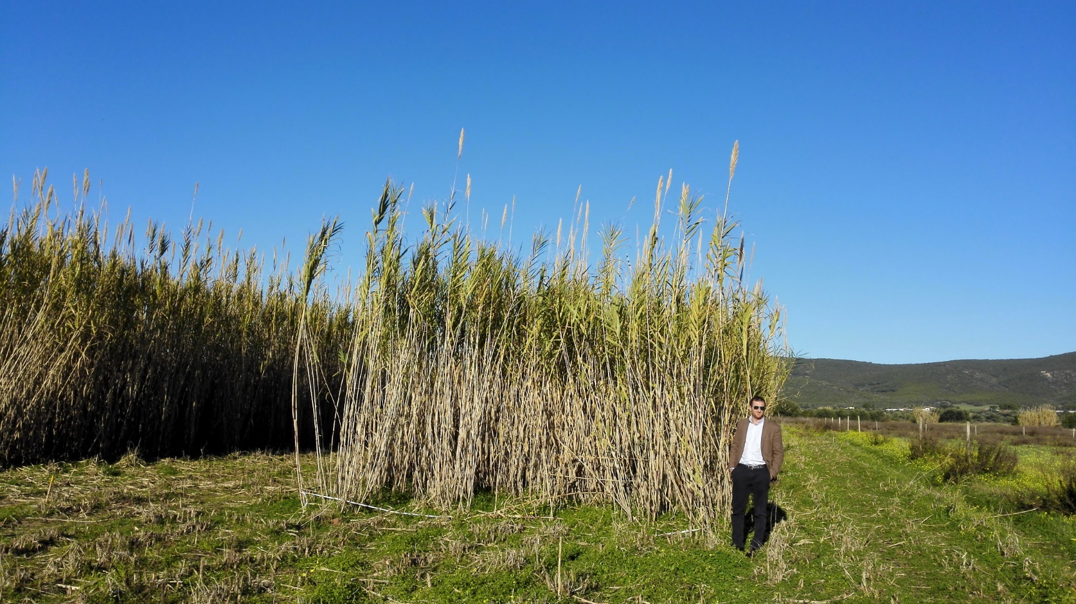
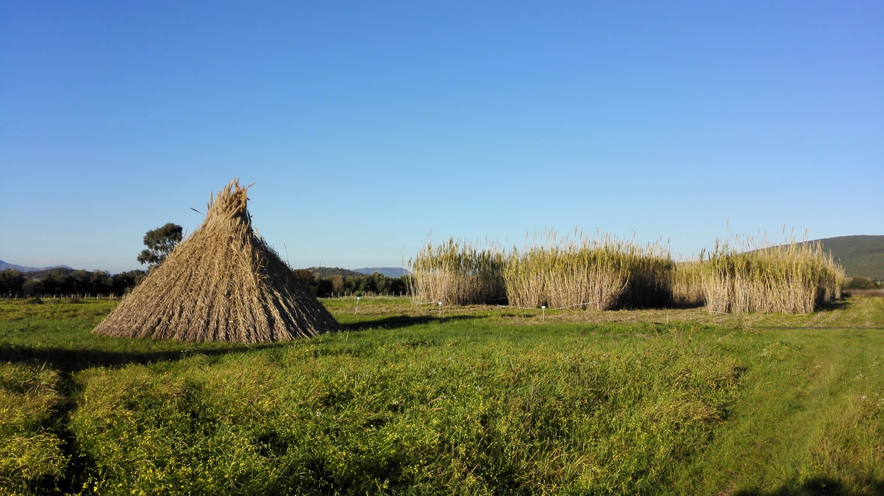
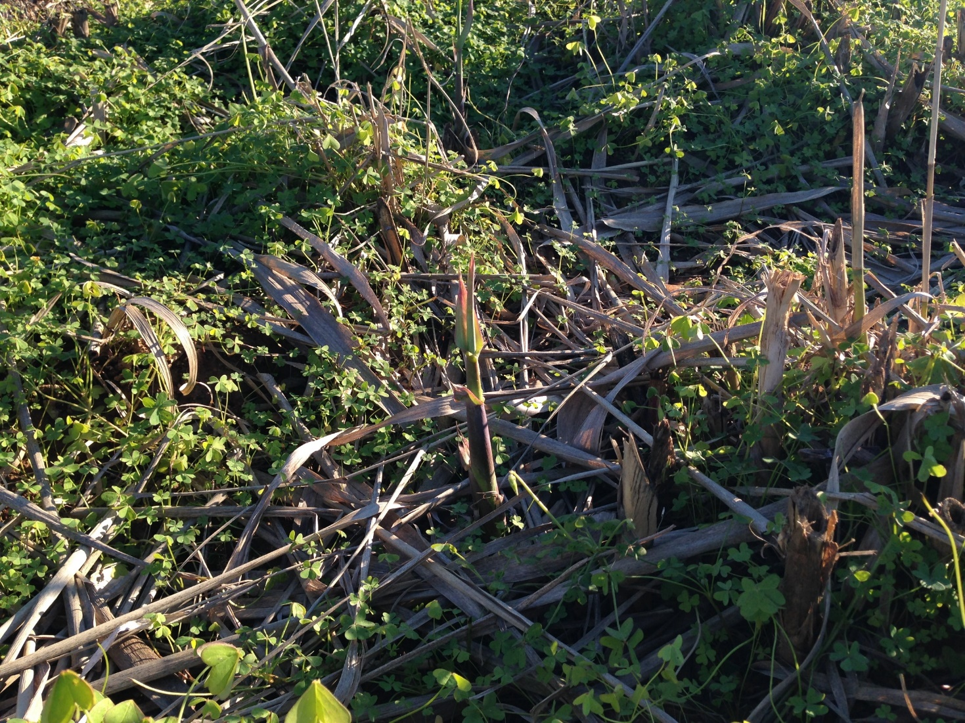
Agronomic Feasibility - Italy
Which crop(s)? Arundo donax L.
Potential strengths:
Low input, high production, rusticity, attitude to energy conversion, positive environmental impact (Nassi o Di Nasso et al., 2013)
Weaknesses:
Implantation costs
Eradication
Nassi o di Nasso N., Roncucci R., Bonari E. (2013) - Seasonal Dynamics of boveground and Belowground Biomass and Nutrient Accumulation and Remobilization in Giant Reed (Arundo donax L.): A Three-Year Study on Marginal Land. BioEnergy Research 6(2):1-12
Notes:
The objective of this field area was to study the potential integration of energy crops into existing farming models to minimize food displacement risk.

Slide 16
GIS data collection and land suitability modelling Where?
Agronomic Feasibility - Italy
Notes:
Was carried out a GIS data collection and land suitability modelling

Slide 17
GIS-based evaluation on marginal and contaminated land potentially suitable for biomass production within existing land use patterns The land suitability modelling follows a multicriteria decision-making approach by considering diagnostic criteria based on the literature reviewed and results of field trials
Agronomic Feasibility - Italy
Where? GIS-based evaluation

Slide 18
In view of environmental sustainability, in this study we applied very restrictive and precautionary constraints in terms of environmental factors (i.e. soil, water, flora and fauna, biodiversity and landscape)
Agronomic Feasibility - Italy
Where? GIS-based evaluation

Slide 19
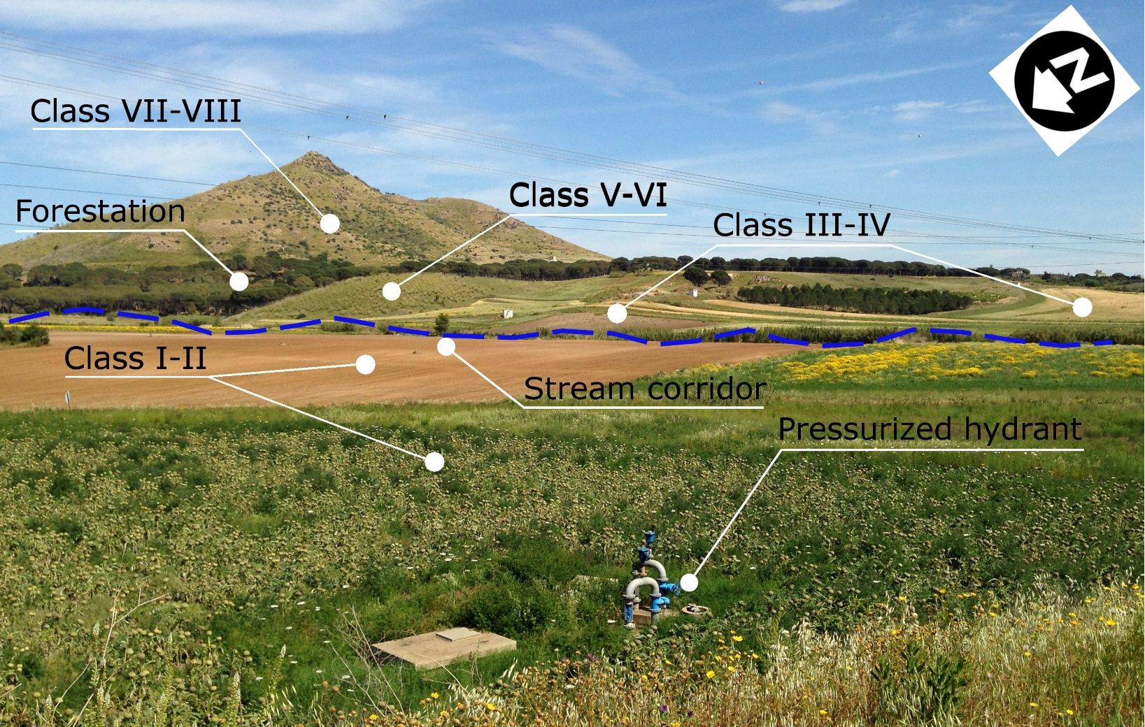
Agronomic Feasibility - Italy
Where? GIS-based evaluation

Slide 20
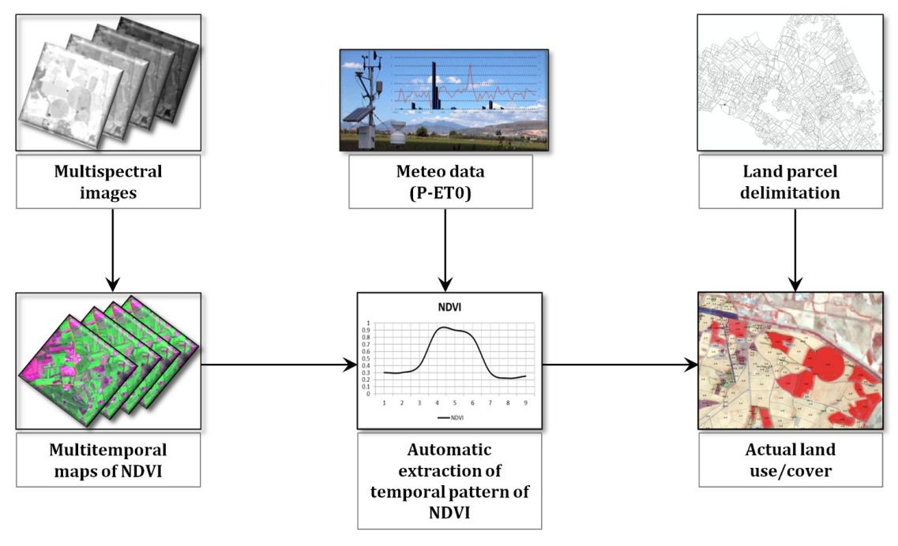
Data sources and constraints
INPUT DATA | RESOLUTION | CONSTRAINTS | DATA SOURCE
Land use/land cover | ~ 1:10,000 | orchards, forestry | CREA
Corine Land Cover | 1:25,000 | orchards, forestry | EEA
Natural areas | 1:10,000 | whole areas | RAS
Restricted areas | 1:10,000 | whole areas | RAS
Soil data | 1:250,000 | 1st - 2nd capab. class >5th capab. class | RAS
DEM | 10 m | >10% | RAS
Meteorological data | ~ 1 km | <300 mm year⁻¹ <15° C year⁻¹ | WorldClim
Hydrography | 1:10,000 | 150 m buffer | RAS
Roads | 1:10,000 | 150 m buffer | RAS
Built up areas | 1:10,000 | 150 m buffer | RAS
Irrigation borders | 1:10,000 | 150 m buffer | CREA

Slide 21
Flowchart illustrating the methodology developed to estimate the amount of suitable marginal land
Notes:
This step is structured in two phases.
The ﬁrst phase aims to identify the availability map, consisting on an exclusion approach derived from environmental, topographic and climatic constraints, as a result of specific potentials and limitations of crops species evaluated.
The second phase aims to derivate the suitability map, as a result of agronomic and economic choices made to avoid the competition and conflict with food crops.

Slide 22
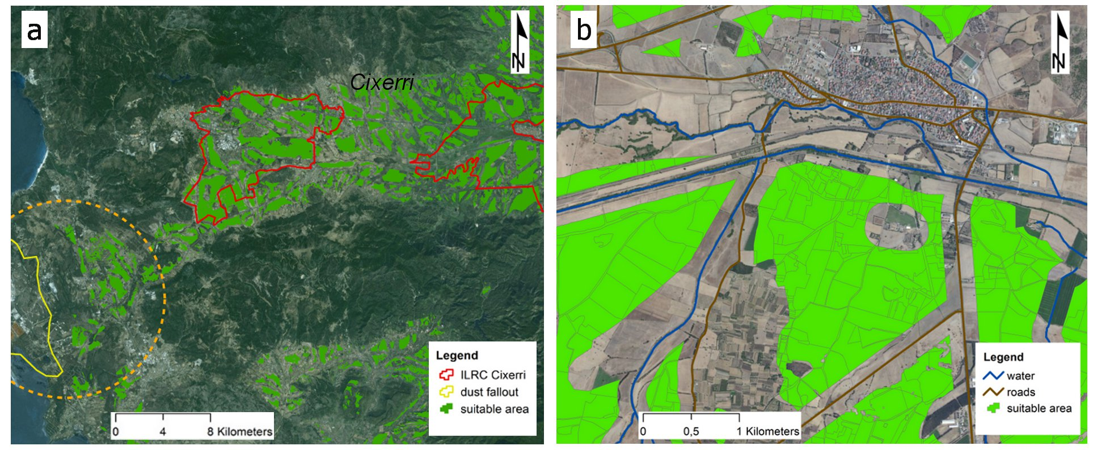
(a) Suitable marginal lands for ILRC‘Cixerri’. Dashed circle indicates the most contaminated area; (b) Zoom-in on suitable areas nearby buffer zones around built-up areas, rivers and roads.
Notes:
The results provide an insight into the interplay between land suitability, original land uses, bioenergy crop type and yield in determining overall impacts on actual agricultural system and go some way towards developing a framework to support technical and economical feasibility process, as well as for the evaluation of environmental sustainability of the cultivation in the study area.

Slide 23
TECHNO-ECONOMIC FEASIBILITY
This Techno-economic feasibility study intends to analyze the different options available for the development of a sustainable feedstock production in Sulcis region in Sardinia, based on Arundo donax L. to produce advanced biofuels as, for example, lignocellulosic ethanol.
It is based on the previous Agronomic Feasibility Study to determine the most promising biomass type for the region and the available underutilised land in a 70 km maximum radius from an hypothetical plant.
The two principal questions to address are:
how?
at what cost?

Slide 24
TECHNO-ECONOMIC FEASIBILITY
From farm to fuel:
A scenario including a bioethanol plant in Portovesme has been hypothezised, with the following assumptions:
Technology: Lignocellulosic bioethanol technology for fuel production
Plant Capacity: 40.000 tons/year
Mean biomass productivity: 25 dry tons/hectare
Area needed for biomass production: 8.000 hectares
Collection radius from the plant: 40 km. Since 70 km radius allows for a theoretical very large area available (50.000 ha), it seems realistic that in practice the collection radius could be reduced.
Harvesting method: single-pass with loading on a tractor trailer

Slide 25
RESULTS
Agronomic Feasibility

Slide 26
Agronomic Feasibility – RESULTS
Which crop(s)? Perennials
The study suggests some good candidates
for a large-scale regional deployment
Giant Reed (Arundo Donax L.)
Smilo Grass (Piptatherum miliaceum L.)
Cocksfoot (Dactylis glomerata L.)
Tall fescue (Festuca Arundinacea S.)
Notes:
The native germplasm of Smilo Grass, Cocksfoot and Tall fescue have recorded higher yields than Arundo Donax, with less input, probably due to the adaptation to local ecological constraints.
Tall fescue and cocksfoot are fully mechanized for hay production.
However, their current use for hay or pasture suggests caution when envisaging cultivation for bioenergy production.

Slide 27
Agronomic Feasibility – RESULTS
Which crop(s)? Arundo Donax L.
Advantages
Good comparative yields (up to 25 t/ha)
Modest irrigation and nutrient needs
Rhizome: water efficiency
No-till after year 1 (soil carbon stock)
Ecological services for biodiversity

Slide 28
Agronomic Feasibility – RESULTS
Which crop(s)? Giant Reed Arundo Donax L.
Disadvantages
Invasiveness
Buffer strips around fields to manage risk
(asexual reproduction)
Notes:
T

Slide 29
Agronomic Feasibility – RESULTS
Which crop(s)? Irrigation for Arundo Donax
Crop water requirements
~ 600 mm in the best performing ﬁeld trial
Giant reed proved to be a very plastic crop (Borin et al., 2013)
able to achieve impressive production under high-input,
but at the same time able to provide proﬁtable productions
in marginal land
Borin, M.; Barbera, A.C.; Milani, M.; Molari, G.; Zimbone, S.M.; Toscano, A. (2013) - Biomass production and N balance of giant reed
(Arundo donax L.) under high water and N input in Mediterranean environments. Eur. J. Agron. 51, 117–119.
Notes:
Availability of water for irrigation in Sardinia is a very sensible topic, especially in view of climate change. CROPWAT was used to quantify the annual water requirements of Arundo Donax based on CLIMWAT data.
Kc refers to the crop coefficient, which incorporates crop characteristics and crop type, plant health and averaged effects of evaporation from the soil.
ET0 represents the reference evapotranspiration, which expresses the evapotranspiration from a hypothetical grass reference crop not short of water.
Irrigation requirements are defined as the water volume needed to equilibrate the water deficit between evapotranspiration and rainfall during the growing period.
Effective rainfall is the part of the total amount of precipitation that is retained by the soil so that it is potentially available for meeting the water need of the crop

Slide 30
Agronomic Feasibility – RESULTS
Which crop(s)? Annuals
Milk Thistle (Silybum marianum L. Gaertn.)
(Asteraceae > CARDUEAE CROP)
Good yield under non-irrigated conditions
(up to 20 t/ha)
Interesting content of fermentable sugars
Good impact on the ecological system
32
Notes:
Availability of water for irrigation in Sardinia is a very sensible topic, especially in view of climate change. CROPWAT was used to quantify the annual water requirements of Arundo Donax based on CLIMWAT data.
Kc refers to the crop coefficient, which incorporates crop characteristics and crop type, plant health and averaged effects of evaporation from the soil.
ET0 represents the reference evapotranspiration, which expresses the evapotranspiration from a hypothetical grass reference crop not short of water.
Irrigation requirements are defined as the water volume needed to equilibrate the water deficit between evapotranspiration and rainfall during the growing period.
Effective rainfall is the part of the total amount of precipitation that is retained by the soil so that it is potentially available for meeting the water need of the crop

Slide 31
RESULTS - Where?
Agronomic Feasibility – RESULTS
Availability of 51,000 ha in a 70 km radius from Portoscuso
Availability of 1,000 ha in the contaminated area (irrigation)
Conclusion
Overall, this study strengthens the idea that energy crops can be successfully grown on marginal lands
The study suggest a potential to increase the production of 2G biomass crops without impacting significantly on food crop production
Incorporating bioenergy crops on marginal lands require a strategic, spatially explicit landscape design
33
Notes:
According to our GIS-based multi-criteria approach, the total area suitable for biomass cultivation, considering a supply radius of 70 km from a hypotetical biorefinery located in Portoscuso was 51,000 ha.
Within ILRC “Cicerri”, according to these results and considering an average production of 15 Mg ha⁻¹, approximately 85,000 Mg of biomass can be produced considering a land-sparing scenario (all available surface cultivated) compared with 43,000 Mg from the land-sharing scenario (only suitable land).
With regard to the most contaminated area, the available surface for biomass cultivation resulting from our suitability model is approximately 1,000 ha. Taking into account that the area is outside the areas equipped with irrigation infrastructures, the most suitable crops should be rainfed species.
There is therefore the potential to increase the production of 2G biomass crops without impacting significantly on food crop production.

Slide 32
Available land areas within the ILRC ‘Cixerri’
Agronomic Feasibility – RESULTS
RESULTS - Where?
AVAILABLE AREAS | ILRC “CIXERRI”
Total area | 9,180
Equipped area with irrigation infrastructures | 6,580
Arable land | 6,104
Arable land - soil class I – II | 1,186
Arable land - soil class III – V | 4,813
Rainfed arable land 2015 | 5,679
Irrigated arable land 2015 | 425
Vineyards, orchards 2015 | 477
Woods, natural areas 2015 | 803
Land suitability area¹ | 2,883
¹ Data obtained by subtracting land use/cover layer constraints from land suitability map.
Notes:
According to our GIS-based multi-criteria approach, the total area suitable for biomass cultivation, considering a supply radius of 70 km from a hypotetical biorefinery located in Portoscuso was 51,000 ha.
Within ILRC “Cicerri”, according to these results and considering an average production of 15 Mg ha⁻¹, approximately 85,000 Mg of biomass can be produced considering a land-sparing scenario (all available surface cultivated) compared with 43,000 Mg from the land-sharing scenario (only suitable land).
With regard to the most contaminated area, the available surface for biomass cultivation resulting from our suitability model is approximately 1,000 ha. Taking into account that the area is outside the areas equipped with irrigation infrastructures, the most suitable crops should be rainfed species.
There is therefore the potential to increase the production of 2G biomass crops without impacting significantly on food crop production.

Slide 33
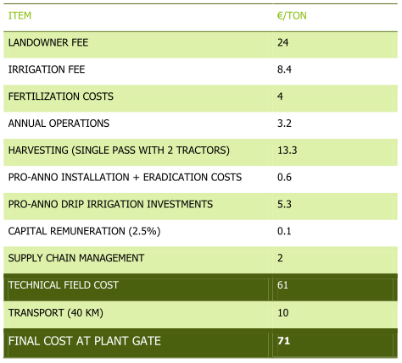
TECHNO-ECONOMIC FEASIBILITY: Results
This model shows a theoretical cost 71 €/dry ton of biomass for biomass delivered to the plant gate and collected in a radius of 40 km.

Slide 34
THANKS FOR YOUR ATTENTION!
Guido Bonati
CREA – Research Centre for Agricultural Policies and Bioeconomy
via Po, 14
00198 Rome, Italy
www.crea.gov.it
Giuseppe Pulighe
CREA – Research Centre for Agricultural Policies and Bioeconomy
via Carloforte, 51
09123 Cagliari, Italy
www.crea.gov.it
For more information visit our website:
http://www.forbio-project.eu

