Slide 1
Sustainability assessment: Italian Case Study
Marco Colangeli
Programme Adviser
Food and Agriculture Organization of the United Nations
Tuesday, 27 November 2018
FAO Headquarters
Rome, Italy

Slide 2
FULL results AVAILABLE: https://forbio-project.eu/documents
FORBIO

Slide 3
Sustainability Assessment Process
FORBIO

Slide 4
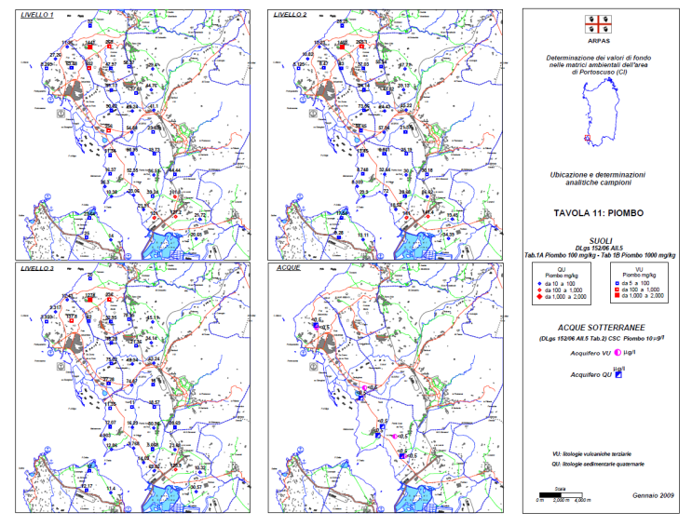
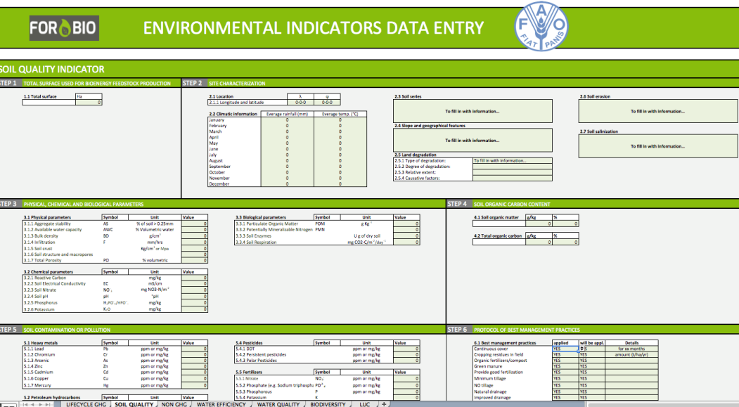
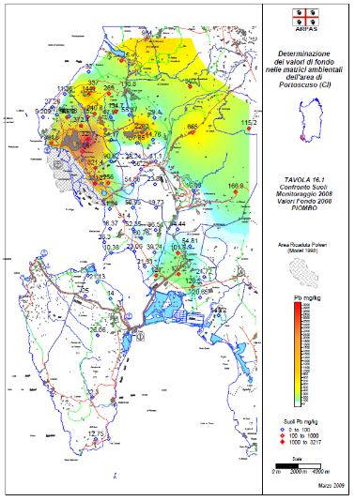
FAO’s approach to the Sustainability Assessment in FORBIO:
Harmonized Data collection campaign (Data entry sheets + literature)

Slide 5
FAO’s approach to the Sustainability Assessment in FORBIO:
Harmonized Data collection campaign (Data entry sheets + literature)
Development of tailored set of Sustainability Indicators (adapted from GBEP SI)
FORBIO SUSTAINABILITY INDICATORS
ENVIRONMENTAL | SOCIAL | ECONOMIC
Life-cycle GHG | Land Tenure | Productivity
Soil Quality | Change in Income | Net Energy Balance
Non GHGs | Jobs in Bioenergy Sectors | Gross Value Added
Water Use and Efficiency | Modern Energy Access | Trainings
Water Quality |  | Infrastructures and logistics for bioenergy distribution
Biodiversity
Land Use Change |  | Capacity and flexibility of use of bioenergy

Slide 6
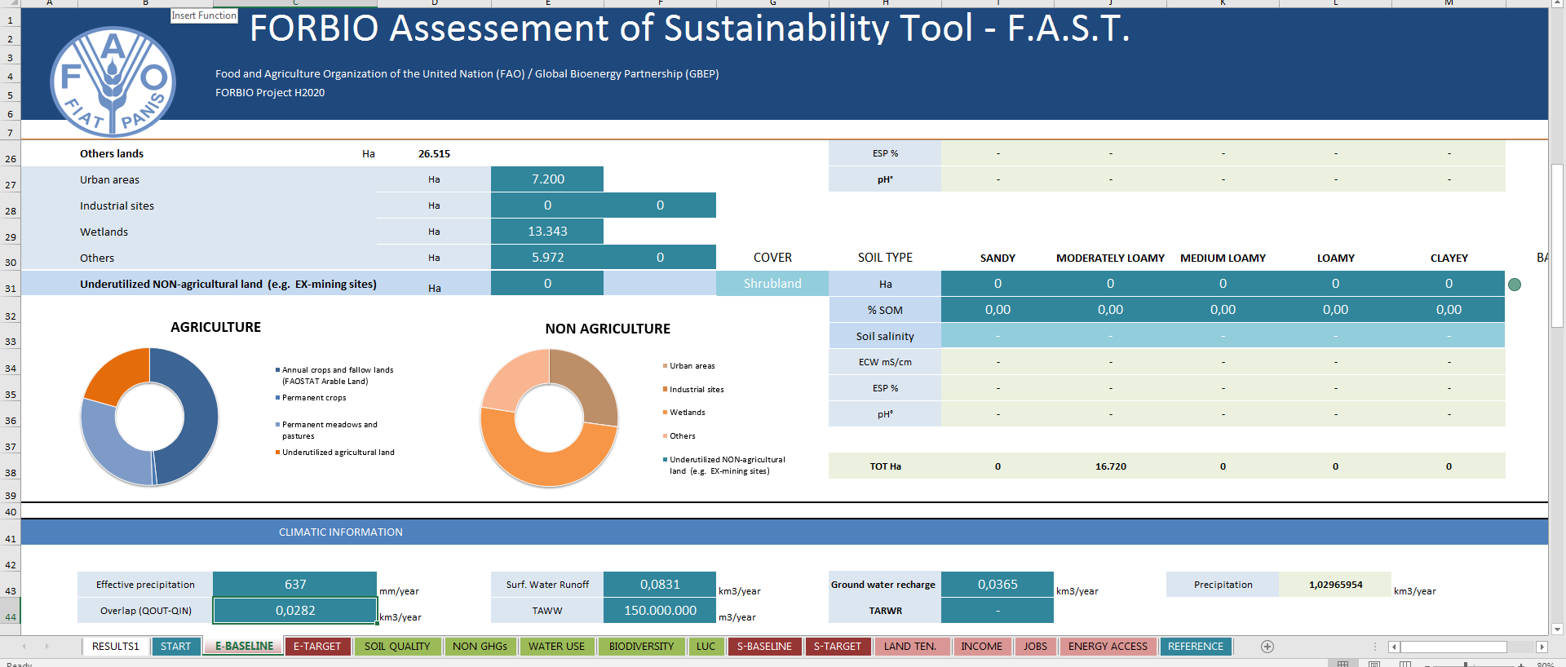
FAO’s approach to the Sustainability Assessment in FORBIO:
Harmonized Data collection campaign (Data entry sheets + literature)
Development of tailored set of Sustainability Indicators (adapted from GBEP SI)
Indicators measurement through purpose built calculator

Slide 7
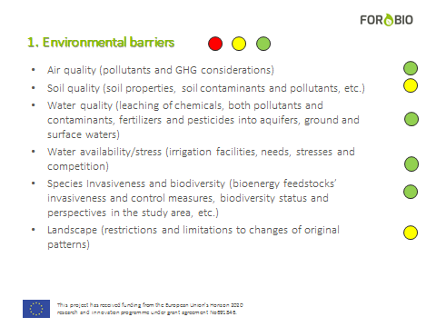
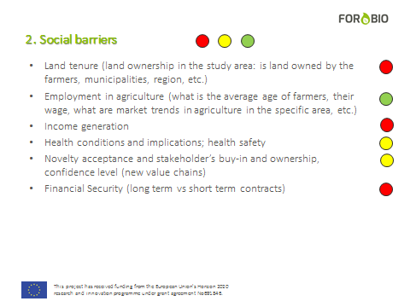
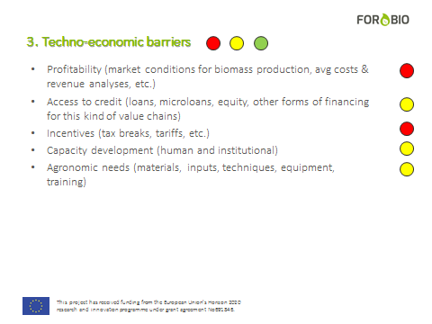
FAO’s approach to the Sustainability Assessment in FORBIO:
Harmonized Data collection campaign (Data entry sheets + literature)
Development of tailored set of Sustainability Indicators (adapted from GBEP SI)
Indicators measurement through purpose built calculator
Further discussions with local stakeholders

Slide 8
AIR QUALITY (GHG + NON-GHG Emissions)
In the baseline scenario the reference fuel used is petrol. The emission intensity of European petrol is 83.3 gCO2eq/MJ (Biograce, 2014).
The PROESA technology foresees the use of by- and co-products of the ethanol value chain and thus an allocation among the various products was performed (energy content).
The 40,000 tons of lignocellulosic ethanol produced yearly are equal to 1,072,400,000 MJ. The generation of 104 GWh of electricity in excess to what is used in the processing stages, equals to a further 374,400,000 MJ.
Ethanol: 74 percent
Surplus electricity: 26 percent

Slide 9
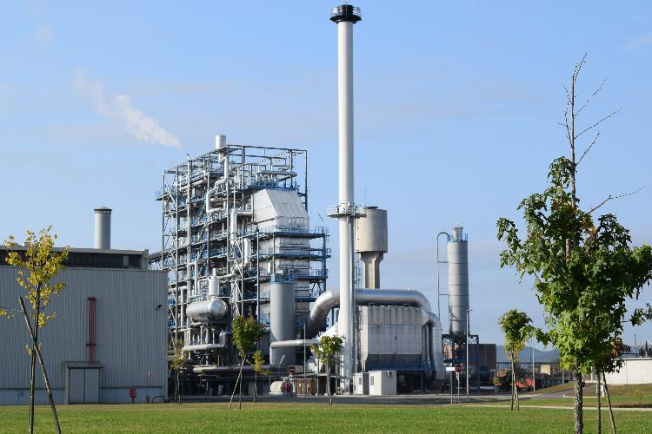
AIR QUALITY (GHG + NON-GHG Emissions)
Information related to processing stage are based on the model biorefinery of Crescentino, Italy.
This plant relies on off-site production of enzymes and yeast.

Slide 10
AIR QUALITY (GHG + NON-GHG Emissions)
Target 1): lignocellulosic ethanol from giant reed irrigated
Emission intensity of lignocellulosic ethanol (allocated results): 26.36 gCO_{2eq}/MJ
Emission reduction compared to baseline: 68.54%
Avoided emissions: 61,227 tons CO₂ per year
Target 2): lignocellulosic ethanol from giant reed rainfed
Emission intensity of lignocellulosic ethanol (allocated results): 30.19 gCO_{2eq}/MJ
Emission reduction compared to baseline: 63.97%
Avoided emissions: 57,147 tons CO₂ per year

Slide 11
AIR QUALITY (GHG + NON-GHG Emissions)

Slide 12
AIR QUALITY (GHG + NON-GHG Emissions)

Slide 13
SOIL QUALITY
In agricultural lands in this part of Sardinia, the SOC loss rates are rather high. Arca (2016) assessed these changes to be between 7.36 and 9.67 tons per ha per year.
The cultivation of a perennial reed, a plant that requires site preparation only at year of implant and zero tillage during the growing cycle of the plantation (25 years) and the plant returns considerable amounts of biomass (and thus C) to the soil. These two aspects somehow counterbalance SOC removal in the target scenario
Arca (2016), measured in three experiemental fields in the target area the changes in SOC due to the cultivation of giant reed:
The losses in the target scenario are reduced to 0.45 Mg of C ha⁻¹ year⁻¹ from 7.36 Mg of C ha⁻¹ year⁻¹ : 94 percent reduction in SOC loss.

Slide 14
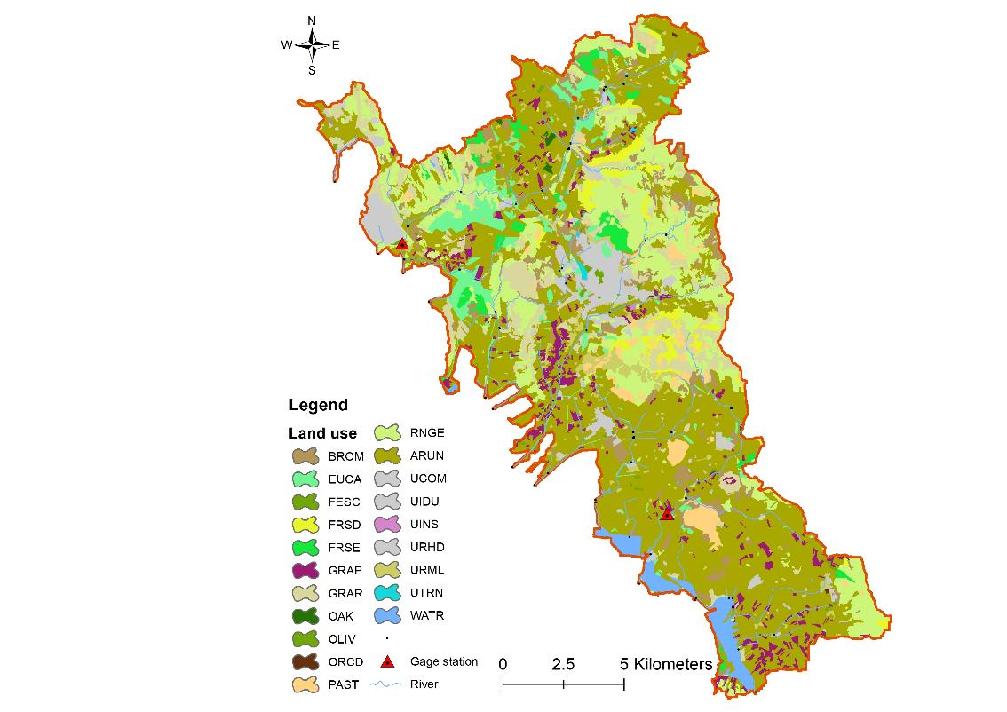
WATER QUALITY
Scenario | Sediment loading | Total N losses | Surface runoff
Baseline scenario | 2.4 Mg/ha | 33.2 kg/ha | 64.3 mm/yr
Target scenario | 1.12 Mg/ha | 16.4 kg/ha | 68 mm/yr
Change | -64% | -51.61% | +5.7%
The impacts of biomass production on water quality have been determined by Giuseppe Pulighe (CREA) using the SWAT Model (USDA).
This assessment is to date the most reliable and accurate method to predict long term movement of matter (especially N fertilizer) into the bodies of water as a consequence of the transport, runoff, and leaching
Secondly, because this pioneering application of SWAT in this specific context will constitute a novelty in the specialized literature and it is expected to lead to further research in this field.

Slide 15
BIODIVERSITY
The target area in Ukraine is vast. As a consequence also the amount of high biodiversity value areas is considerable at 48,915 ha. Most of these areas are forested and shrubs.
The remaining 132,819 hectares within the target area that are not interested by the presence of critical habitats are likely to host species considered endangered in Europe (e.g. Hamster, Skylark, and the Ortolan bunting).

Slide 16
BIODIVERSITY
It was not possible to measure quantitatively species richness of the current underutilized and contaminated lands, and in literature only anecdotal information was retrieved.
According to many authors, in willow short rotation coppice plantations in England higher biodiversity was detected when compared to nearby cropland and set-aside land.
Particularly at the landscape level, the presence of SRC plantations would represent a valuable asset for species diversity and abundance as a consequence to an enhanced variety of habitats.
The presence of willow SRC seems to be superior to the current land use from the biodiversity point of view.

Slide 17
INCOME
The cost-benefit analyses for the T1 and T2 scenarios are based on information from Deliverable 2.2 (techno-economic feasibility). Assuming a premium paid to the farmer for the production of biomass of EUR 24/t, the cultivation of giant reed may generate a net income of 240 EUR/ha in rainfed conditions or EUR 600/ha in irrigated conditions.
Assuming as in the case of durum wheat that the average farm size is between 5 and 20 ha, the net income of a farm producing biomass for a lignocellulosic ethanol value chain would be 1,200 – 3,000 EUR/year for farms up to 5 hectares of surface (T2 and T1 respectively), and 4,800 – 12,000 EUR/year for a 20 ha farm (T2 and T1 respectively).

Slide 18
INCOME
Durum Wheat: 3.5 t/ha
Production cost: 992 EUR/ha
Price: 234 EUR/t
Revenue: (234 EUR/t * 3.5 t/ha) – 992 EUR/ha = - 170 EUR/ha
Breakeven price for wheat in Italy is 280 EUR/t in 2018, minimum income achieved at EUR 300/t.
CAP: 150 + 50 EUR/ha
Total Income: -170 EUR/ha + 200 EUR/ha = 30 EUR/ha
Biomass – Arundo Rainfed: 10 t/ha
Production cost: 57 EUR/ha (source: FORBIO D 2.2)
Landowner fee: 24 EUR/t (source: FORBIO D 2.2)
Total Income: (24 EUR/t * 10 t/ha) = 240 EUR/ha
Biomass – Arundo IRRIGATED: 25 t/ha
Production cost: 61 EUR/t (source: FORBIO D 2.2)
Landowner fee: 24 EUR/t (source: FORBIO D 2.2)
Total Income: (24 EUR/t * 25 t/ha) = 600 EUR/ha

Slide 19
PRODUCTIVITY
This indicator includes several aspects: biomass yield, fuel yield, production cost.
The estimate of production cost was performed through a number of calculations and data obtained both from direct communication with Biochemtex and information found in the specialized literature.
CAPEX:
EUR 150,000,000 for a 40,000 t/year biorefinery (Crescentino, Italy)
OPEX
Feedstock expenditure: EUR 12,780,000 per year
Enzymes, yeast, catalysts, other inputs: EUR 13,000,000 per year (E4tech, 2017)
Salaries: EUR 2,952,000 per year
Miscellaneous: EUR 1,200,000 per year

Slide 20
PRODUCTIVITY
In total the production cost of lignocellulosic ethanol was calculated to be EUR 936 per ton.
This value calculated in the real case scenario of FORBIO was compared to values found in literature. According to E4TECH (2017), lignocellulosic ethanol production costs in Europe range between EUR 940 and 1,010 per ton.

Slide 21
GROSS VALUE ADDED
The current European price for ethanol is registering an all-time low at 424 EUR/m³ (534 EUR/t).
At current market prices, sales of ethanol would generate some 21,360,000 EUR/year.
At the current price of electricity for large scale biomass-fueled power plants of EUR 115/MWh as per DM 26 July 2016, (Gazetta Ufficiale, 2016) revenues for the generation of electricity would account to EUR 11,960,000 per year for the next 20 years.
Total revenues for a 40,000 t/year biorefinery at current market conditions would then be EUR 33,320,000 per year.

Slide 22
GROSS VALUE ADDED
However, the total production cost of lignocellulosic ethanol in Sardinia as we have seen in previous chapter would be 936 EUR/t or 37,440,000 EUR/year
Thus, given the current market conditions, the Gross Value Added of a second generation biorefinery would be negative by some EUR 4,120,000 per year
Ethanol price volatility though is a key parameter
At 2017 prices the GVA would be positive by EUR 4.7 million

Slide 23
CAPACITY AND FLEXIBILITY OF USE
This indicator measures the contribution to reaching the capacity of using bioenergy in the reference area. In other words, how much advanced bioethanol can be absorbed in the reference area? And what share of this is provided through the case study value chain?
Notes:
The capacity of a fleet to use biofuels in the case of ethanol is given by the maximum amount of biofuel that can me blended with gasoline without requiring retrofitting of the fleet (blend wall). According to the European Petroleum Refiners Association (EPRA, 2018) this amount is 10% for petrol engines in Europe.
To date in Italy the current ethanol blend in petrol is 3.95%.

Slide 24
The roadmap Italy
FORBIO

Slide 25
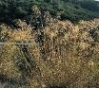
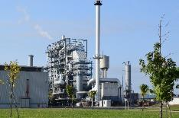
2019
EU
Local Authorities
Member State
FUEL company
Excise
break
7/8 Biofuel-driven refineries
Sanctions
BIOREFINERY PLANNING
EUR 750/10Gcal
EUR 1,500/10Gcal
RED II
Consortia
1,000 ha irrigation infrastr.
17,000 ha NO IRR
Psychologic incentive at the pump (consumers)
Increased demand (fuel blenders)
2020
Smilo grass
Direct or Indirect Support (BMP)
1-year contracts
BIOREFINERY CONSTRUCTION
Reconv. Illegal grazing
Demand
Arundo IRR
Arundo RAINFED
Milk thistle
25-year contracts
5-year contracts
2021
2030
3.5% ADV BIOFUEL = 50 additional Biorefineries
60 Biorefineries
Supply 40,000 t/yr lignocellulosic ethanol
Notes:
List of biorefineries in Europe
https://biorrefineria.blogspot.com/p/listado-de-biorrefiern.html?m=1

Slide 26
Thank you

