Slide 1
WP4: Identification and removal of barriers to the market uptake of bioenergy in the case study sites
FORBIO Final Project Meeting, Rome, Italy
Marco Colangeli (FAO)
26 November 2018

Slide 2
Analysis of the economic and non-economic barriers to the market uptake of the selected sustainable bioenergy technologies in the case study sites;
TASK 4.1 Best practices for bioenergy policies, regulations and support schemes which allow the most sustainable and efficient use of bio-resources from under-utilized land (Led by GEO);
TASK 4.2 Background research on the economic and non-economic barriers to the market uptake of the selected sustainable bioenergy technologies in the case study sites (Led by FAO);
Task 4.3 Discussions with relevant economic actors and stakeholders on the economic and non-economic barriers to the market uptake of the selected sustainable bioenergy technologies in the case study sites (Led by FAO);
Task 4.4 Identification of actions for removing the main economic and non-economic barriers and definition of roles and responsibilities of relevant stakeholders for removing such barriers (Led by FAO);

Slide 3
TASK 4.2: Background research on the economic and non-economic barriers to the market uptake of the selected sustainable bioenergy Led by FAO
FORBIO

Slide 4
1. Environmental barriers
Air quality (pollutants and GHG considerations)
Soil quality (soil properties, soil contaminants and pollutants, etc.)
Water quality (leaching of chemicals, both pollutants and contaminants, fertilizers and pesticides into aquifers, ground and surface waters)
Water availability/stress (irrigation facilities, needs, stresses and competition)
Species Invasiveness and biodiversity (bioenergy feedstocks’ invasiveness and control measures, biodiversity status and perspectives in the study area, etc.)
Landscape (restrictions and limitations to changes of original patterns)

Slide 5
2. Social barriers
Land tenure (land ownership in the study area: is land owned by the farmers, municipalities, region, etc.)
Employment in agriculture (what is the average age of farmers, their wage, what are market trends in agriculture in the specific area, etc.)
Income generation
Health conditions and implications; health safety
Novelty acceptance and stakeholder’s buy-in and ownership, confidence level (new value chains)
Financial Security (long term vs short term contracts)

Slide 6
3. Techno-economic barriers
Profitability (market conditions for biomass production, avg costs & revenue analyses, etc.)
Access to credit (loans, microloans, equity, other forms of financing for this kind of value chains)
Incentives (tax breaks, tariffs, etc.)
Capacity development (human and institutional)
Agronomic needs (materials, inputs, techniques, equipment, training)

Slide 7
TASK 4.3: Discussions with relevant economic actors and stakeholders on the economic and non-economic barriers to the market uptake of sustainable bioenergy (case of ukraine) Led by fao
FORBIO

Slide 8
Task 4.3: Process and requirements
According to project document:
“A 2-day workshop will be organized in each of the case study sites, with at least 20 participants from the following stakeholder groups:
National and local governmental bodies;
Farmers and farmers’ associations;
Industry associations; and
Civil society organizations. “

Slide 9
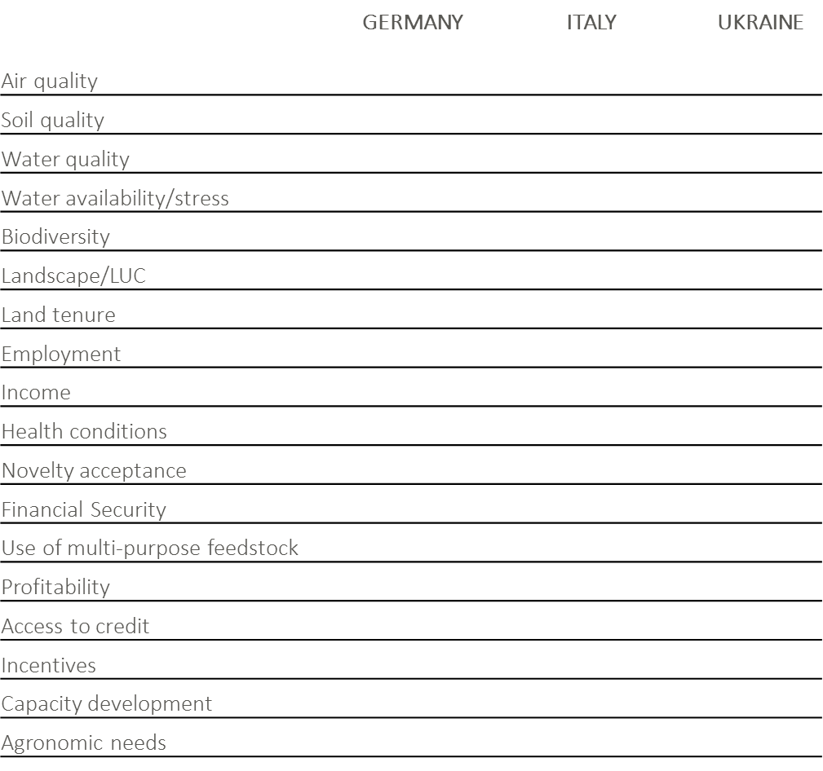

Slide 10
TASK 4.4: Identification of actions for removing the main economic and non-economic barriers and definition of roles and responsibilities of relevant stakeholders for removing such barriers.
FORBIO

Slide 11
EU-Level
+ The technology for the sustainable production of lignocellulosic ethanol exists.
- However, Best Management Practices (e.g. on-site enzymes production) are to be incentivized.
+ Policy environment promotes the diffusion of ADV Biofuels in EU MS:
REDII: mandates 3.5% ADV BIOFUEL in Transport by 2030 (+50 biorefineries)
- Without some form of support (either direct or indirect) it is unlikely that this goal will be met
- ADV Biofuels require long term investments and uncertainty beyond 2030 is a barrier

Slide 12
EU-Level
Advanced biofuel compete on the market with conventional biofuels at international market prices
Ethanol price is highly volatile: In June 2018 was 534 EUR/t; 12 months earlier it was 756 EUR/t.

Slide 13
MS-level: Italy
+ Ministerial Decree 10/10/2014 mandates increasing share of ADV in the blend (i.e. 1.2%, 1.6%, 2% from 2018 through 2020).
- Sanctions’ system does not differentiate between conventional and advanced biofuels
Moreover, sanctions are only monetary and their value is often times lower than the extra expenditure that a fuel market operator would incur if it purchased the set quantity of advanced biofuel.
A fuel supplier that fails to fulfil a quota obligation is liable to pay a penalty of EUR 750 for every missing certificate (10 Gcal) of biofuel set in Decree 20 January 2015

Slide 14
MS-level: Italy
When referring to ethanol, 10 Gcalories are the energy content of approximately 1.15 tonnes of biofuel.
As reported in D3.3, producing 1 ton of lignocellulosic ethanol in the Italian case study scenario would cost approximately EUR 950 and therefore 10 Gcal would cost about EUR 1,114.
Paying the penalty would save the fuel supplier some EUR 364 per certificate, thus making blending advanced bioethanol into petrol economically less convenient than paying penalties.

Slide 15
MS-level: Italy
+ Italy is authorized by the Commission to apply differentiated rates of excise duty to the fuel mixtures "petrol/ethyl alcohol derivatives whose agricultural component is of agricultural origin“
+ Between 2008 and 2010 the Italian government destined about 73 million euros to reduce the excise duty on bioethanol and this translated into a value of the excise of EUR 289/m³
- Past 2010, the excise break was discontinued and at present any biofuel (including advanced ethanol) undergoes the same taxation regime as fossil petrol

Slide 16
Regional-level: Italy
+ Existence of an agricultural ban on production of food and feed from contaminated areas in Sulcis
- Enforcement is scarce and (illegal) agricultural activities, take place
+ Map of contamination exist (dated 2008)
- Several stakeholders requested an independent update and a higher resolution study of the contamination in the area
Action: opening up a discussion table to reorganize in a transparent and fair way agricultural activities currently taking place in the target area.

Slide 17
Regional-level: Italy – Reorganization of the AG activities in the area
Reconversion of the workforce employed in those illegal agricultural and especially pastoral activities.
The reconversion of horticulture can be done quickly, in between two production seasons.
Concerning pastoral activities, typically a sheep herd has an economic lifetime of about 5 – 7 years.
As consequence the reconversion of herders to labour force that could be employed in the biomass industry would require a minimum of 1 to a maximum of 5 years.
Local authorities responsible for enforcing the current ban are the actors expected to convey a first discussion table with the herders, pasture land owners and the associations who represent both of them (e.g. Coldiretti, CIA, etc.).

Slide 18
Regional-level: Italy – Reorganization of the AG activities in the area
Land owners need to be confronted with the parties in the pursue of an agreement as to either i) move the herds; ii) sell the herds; or iii) exploit the current herds until the end of their economic lifetime, but without gradual reconstitution and by agreeing to avoid grazing on the area subject to Law 9 of 06/03/2014.
Herders who choose options i) and ii) should have a 12 months period to relocate their herds.
A period of up to 5 years is necessary to requalify herders who decide to keep the animals until the end of their economic lifetime, while providing that no grazing activities take place on the contaminated soils and forage is procured from other areas.
For these stakeholders, the voluntary inclusion into the advanced biofuel value chain should be guaranteed since the beginning of the operations so that they can make more informed choices.

Slide 19
Value chain-level: Italy
Planning and designing the value chain:
Local authorities should convey working group (composed by farmers, land owners, fuel company representatives, etc.) meetings where all concerned stakeholders are asked to form associations of biomass producers (ABP) or consortia.
The ABP/consortia will design the landscape level arrangement of the biomass supply chain:
Those reached by the irrigation infrastructure should be favoured to grow irrigated giant reed, those in the remaining 17,000 ha have variable choices depending on the specific conditions of the farm.

Slide 20
Value chain-level: Italy
Planning and designing the value chain:
Giant reed growers (both irrigated as well as rainfed) will be offered long-term contracts (25 years) to make their investments bankable;
Farmers that prefer 3-5 years contracts will have the opportunity to grow milk thistle for biomass
Farmers willing to accept only yearly contracts will grow smilo grass.
The presence of the biomass buyer in the working groups planning the arrangement of this diversified production pattern will ensure that the minimum supply is reached.
Contractual forms will be negotiated by the cooperatives in the interest of the associates and by finding a fair agreement with the biomass buyer.

Slide 21
The roadmap Italy
FORBIO

Slide 22
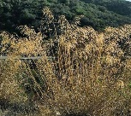
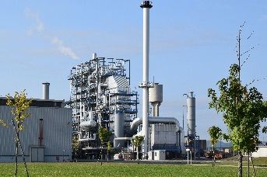
2019
EU
Local Authorities
Member State
FUEL company
Excise
break
7/8 Biofuel-driven refineries
Sanctions
BIOREFINERY PLANNING
EUR 750/10Gcal
EUR 1,500/10Gcal
RED II
Consortia
1,000 ha irrigation infrastr.
17,000 ha NO IRR
Psychologic incentive at the pump (consumers)
Increased demand (fuel blenders)
2020
Smilo grass
Direct or Indirect Support (BMP)
1-year contracts
BIOREFINERY CONSTRUCTION
Reconv. Illegal grazing
Demand
Arundo IRR
Arundo RAINFED
Milk thistle
25-year contracts
5-year contracts
2021
2030
3.5% ADV BIOFUEL = 50 additional Biorefineries
60 Biorefineries
Supply 40,000 t/yr lignocellulosic ethanol
Notes:
List of biorefineries in Europe
https://biorrefineria.blogspot.com/p/listado-de-biorrefiern.html?m=1

Slide 23
The roadmap UKRAINE
FORBIO

Slide 24
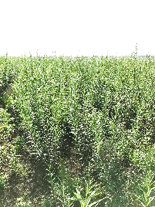
2019
EU
Local Authorities
Ukraine
FUEL company
Extend
Law
«HES»
7/8 Biofuel-driven refineries
BIOREFINERY PLANNING
High Level Agreements
RED II
Consortia
MS
16,720 ha
2020
Domestic incentive for Ren Electricty and Heat
Direct or Indirect Support (BMP)
BIOREFINERY CONSTRUCTION
Demand
Willow SRC
25-year contracts
2021
Non-EU countries?
2030
3.5% ADV BIOFUEL = 50 additional Biorefineries
60 Biorefineries
Supply 33,440 t/yr lignocellulosic ethanol
Notes:
List of biorefineries in Europe
https://biorrefineria.blogspot.com/p/listado-de-biorrefiern.html?m=1

Slide 25
THANK YOU
Marco Colangeli
Programme Adviser
Food and Agriculture Organization of the United Nations (FAO)
Climate and Environment Division (NRC)
Viale delle Terme di Caracalla 00153 Rome – ITALY
Tel: +39.06.0754760
E-Mail: marco.colangeli@fao.org
www.fao.org

