Slide 1

WP5
Knowledge Transfer and Capacity Development for Innovative Value Chains
20th February, 2018
Kiev, Ukraine
Rainer Janssen, Cosette Khawaja
WIP Renewable Energies
Sylvensteinstr. 2
81369 Munich
www.wip-munich.de

Slide 2
FORBIO WP5 - Objectives
Work Package Leader: WIP
Contribution by all partners
Duration: June 2017 to December 2018 (M18-36)
Build capacity for relevant stakeholders
Replicate the knowledge gained to other regions or countries
Encourage European farmers and owners of contaminated lands in selected sites to start action

Slide 3
Task 5.1: Human and institutional capacity assessment
Leader: FAO, contributions: all partners
Capacity assessment at human resource level and institutional level in selected case studies (Germany, Italy, Ukraine) and outreach countries (Romania, Poland, Hungary, Belgium, Ireland, UK)
Characteristics of specific context
Identification of target groups (farmers, local administrators, etc.)
Assessment of learning needs/objectives for capacity development
Deliverable D5.1: Assessment Report (FAO, submitted in April 2018)
Notes:
11 partners from 8 EU MS + 1 partner from Ukraine
The coordinator of FORBIO is WIP-Renewable Energies (Germany)
Started in January 2016 until December 2018, for a duration of 36 months, the project received funding for 1.9 million EUR

Slide 4
Task 5.2 Organisation of info days
Leader: WIP, contributions: all partners
Participants: land owners, farmers, local actors and supply chain stakeholders
Conducted in national language
Presentation of project results (e.g. feasibility, sustainability, advantages)
to initiate the implementation of bioenergy value chains
Deliverable D5.2: Reports on info days in target countries
(WIP, M30, June 2018)

Slide 5
Task 5.2 Result status
Country | Info days in target region | Replication in other regions
Italy | 13-14 October 2016, Carbonia, Sardinia | 20 June 2018, Rome
Ukraine | 12 December 2017, Kiev | 16 May 2018, Cherkasy
Germany | 6 September 2017, Finterwalde | 27 June 2018, Potsdam

Slide 6
Task 5.3 Capacity building for stakeholders
Leader: WIP, contributions: all partners
Participants: stakeholders who show interest in FORBIO approach during info days and through other dissemination channels
Conducted in national language (one-day event)
Content: agronomic, techno-economic, sustainability requirements, overcoming existing barriers
Linked with study tours in Task 5.5
Deliverable D5.3: Reports on training events in target countries (WIP, M32, August 2018)

Slide 7
Task 5.3 Result status
Country | First event | Second event
Italy | 7 June 2018, Cagliari, Sardinia | 19 September 2018, Ferrara
Ukraine | 21 February 2018, Kiev | 17 May 2018, Cherkasy
Germany | 7 April 2018, Goßmar | 12 June 2018, Neuperhain

Slide 8
Task 5.4 Capacity building for stakeholders – outreach countries
Leader: WIP, contributions: all partners
Participants: interested supply chain stakeholders
Conducted in national language (two-days event)
Aim: inform stakeholders about FORBIO project results
Content: combination of info days and training events
Deliverable D5.4: Reports on training events in outreach countries (WIP, M32, August 2018) was delayed and does not include information about the event in Ireland

Slide 9
Task 5.4 Result status
Country | First event | Second event
Belgium | 22 May 2018, Westmalle | 28 July 2018, Libramont
Poland | 24 May 2018, Warsaw | 04 September 2018, Płońsk
Romania | 18 July 2018, Bacau | 31 August 2018, Targoviste
Hungary | 6-7 June 2018, Gödöllő
United Kingdom | 6-7 June 2018, Lincoln

Slide 10
Task 5.5 Study tours
Leader: WIP, contributions: all partners
Participants: stakeholders from target and outreach countries
Conducted in national language/English (one-day event)
Organisation of 3 study tours (one per target country: IT, DE, UK)
Aim: presentation on field activities (planted areas) of target case studies
Integral part of training events (Task 5.3)
Integrated in: Deliverable D5.3: Reports on training events in target countries (WIP, M32, August 2018)

Slide 11
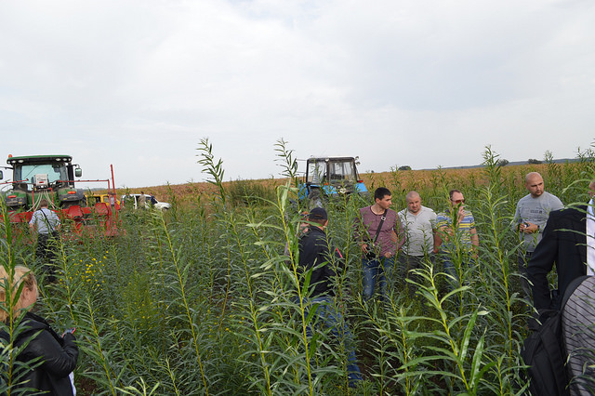
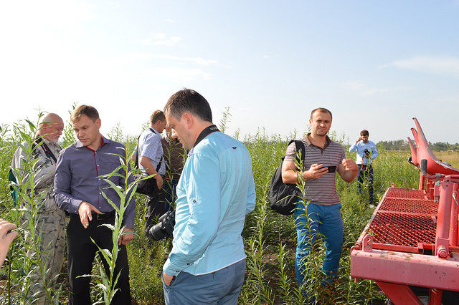
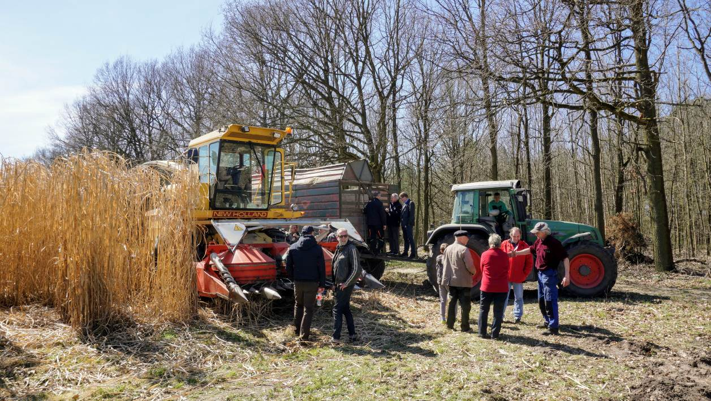
Study tours

Slide 12
Task 5.6 Capacity building – sustainability assessment
Leader: FAO, contributions: all partners
Participants: farmers, local administrators
3 webinars for target countries (one per target country: IT, DE, UK)
3 webinars for outreach countries (ENERO, POLBIOM, FIB)
Aim: train relevant local institutions and experts to implement FORBIO sustainability assessment
Content: methodological and practical issues of the adapted GBEP sustainability indicators for monitoring the impacts of modern bioenergy and their application to local sites
Deliverable D5.5: Reports on webinars (FAO, M33, September 2018)

Slide 13
Task 5.6 Capacity building – sustainability assessment
FAO provided advice on the selection of an adequate webinar platform and coordinated the action of partners who requested further information
FAO prepared a guided questionnaire to backstop participant’s perceptions on most relevant aspects of sustainability in advanced bioenergy value chains on underutilized land
FORBIO partners delivered the presentations during the webinars and led the discussions concerning perceived barriers to the sustainable uptake of the proposed value chains
Each responsible Partner compiled a mini-report on the activities and feedbacks received from the webinar participants and shared it with FAO for the final compilation of the report

Slide 14
Thank you for your attention!
Rainer Janssen, Cosette Khawaja
WIP Renewable Energies
Sylvensteinstr. 2
81369 Munich
www.wip-munich.de
http://www.forbio-project.eu

