Slide 1

Ukrainian Case Study: Agronomic and Techno-economic feasibility
Workshop – The contribution of the FORBIO project to the sustainable
Development of bioenergy
27 November 2018
Rome, Italy
Oleksandra Tryboi, SEC Biomass
03067, Kyiv, PO box 66
www.biomass.kiev.ua

Slide 2
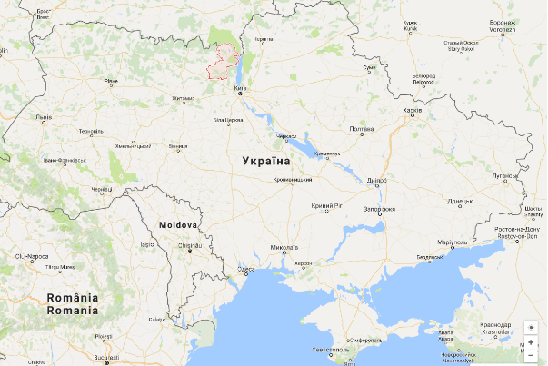
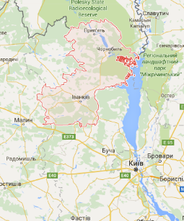
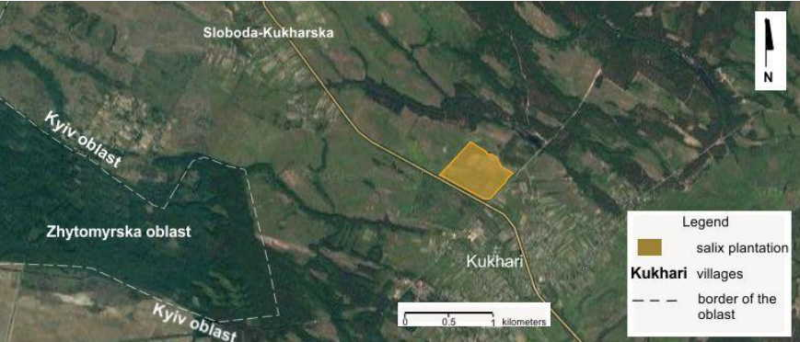
Case study site location description
Country: Ukraine
Region: Kyiv oblast
Province: Ivankiv region (362 th. ha, 12.8% of the Kyiv oblast)
Climate | moderately continental
Average temperature in January | – 6 °С
Average temperature in July | +19.5 °С
Annual average temperature | 6.9 °С
Average altitude | 131 m
Duration of vegetation period | 198-204 days
The annual radiation balance | 45 kcal/cm²
Moisturizing factor (the ratio of precipitation to evaporation) | 1.0-1.2
Annual precipitation | 550-650 mm
Relief | flat
Annual air humidity | 80 %
Wind direction | north-west
Soils types | sandy, sandy loam, sod-podzolic
Case study site is located at the area of 50 ha near Kukhari village approx. 25 km from Ivankiv town.
Notes:
Case study site is located in Kyiv oblast, Ivankiv region in the north part of Ukraine. At zone of mixed coniferous-deciduous forests called Polissia and is characterized by moderately continental climate characterized with relatively mild winters and warm summers. The temperature ranges from -6 degrees Celsius in January to +19.5 degrees Celsius in July.
The forest coverage of the area ranges from 10 to 60% (30% in average). Annual rainfall amount is between 500 - 600 mm. Relief is flat. The snow cover lasts for 90-100 days. Vegetation period lasts from the second decade of April until the third decade of October. Natural conditions of Kyiv Polissia are favourable for agriculture and forestry use, recreation, environmental objects. Population of the Ivankiv region is 30 th people (in the Ivankiv town – 10 th people and in rural areas – 20 th people), representing 2% of the total population of Kyiv oblast.

Slide 3
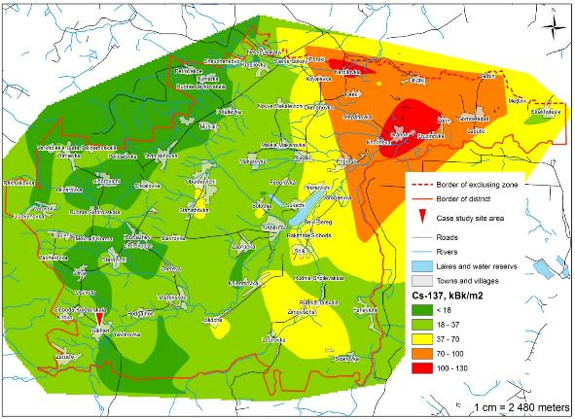
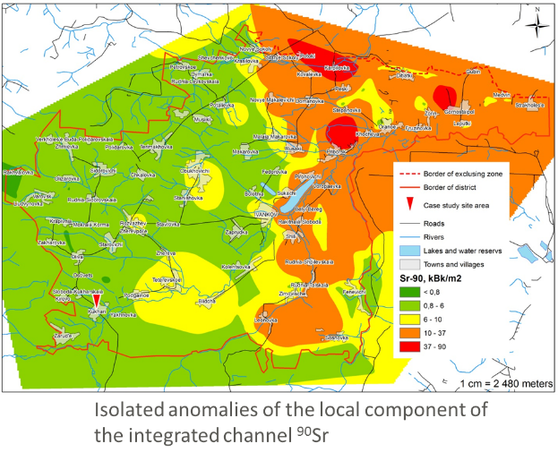
Radiological description of the investigated territory
Isolated anomalies of the local component of the integrated channel ¹³⁷Cs
Notes:
As we can see from gamma survey results only Chornobyl exclusion zone is contaminated with ¹³⁷Cs and ⁹⁰Sr. The case study area is not contaminated with radionuclides and can be used by locals and by companies as well for different purposes.

Slide 4
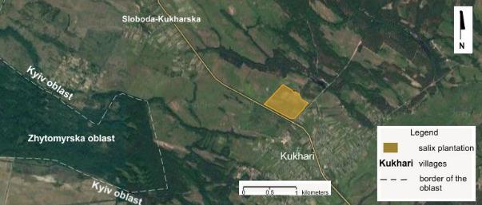
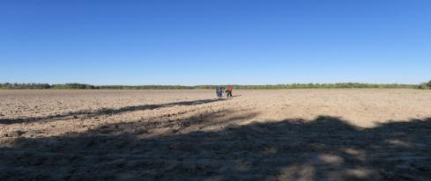
Willow field trials
Experimental field: 50 ha mother plantation is located near Kukhari village of the Ivankiv municipality.
Agricultural lands with sandy, sandy loam soils that were abandoned >10 years ago.
Chemical elements
N | P | K | Ca | Mg | S | Fe | Mn | Zn | Cu | Mo | B | Na
26 | 169 | 43 | 725 | 75 | 11 | 610 | 90 | 2,9 | 1,3 | 0,05 | 0,3 | 10
pH_{KCI} : 5,20
EC mS/cm (electroconductivity): 0,39
█ - low █ - high
Notes:
This section aims at giving the information on Salix viminalis L. field trials started in 2016 near Kukhari village in Ivankiv region. 50 ha mother plantation is located near Kukhari village of the Ivankiv municipality. Agricultural lands with sandy, sandy loam soils that were abandoned 15 years ago.
Three different high-yielding varieties of Salix viminalis L.: “Tora”, “Tordis”, “Inger”
Plantation area operates by “Ukragroenergo company” subsidiary of group of companies “Ukrteplo”, which implements energy efficiency projects on substitution fossil fuels by such local fuels as wood pellets, briquettes, chips, straw etc. Also company bought the old sugar plant in Odesa region and now investigating the possibility to build plant for 2 generation ethanol production from straw or corn stover.
Taking into account the obtained information on crop yield and cultivation conditions on underutilized lands in Ivankiv region, the cellulosic feedstock cost will be identified.
Soil analysis that have been done by the ukrargoenergo company shows low indexes of the content of the next chemical elements in soil that defines its productivity: nitrogen (N), potassium (K), calcium (Ca), magnesium (Mg), sulfur (S), zinc (Z), Cu (copper), boron (B).
Level of pH gives as information that that is acid soil. The level of electroconductivity of soil is low for growing common food agriculture crops.

Slide 5
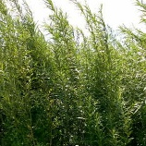
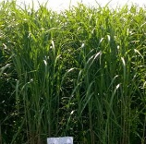
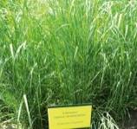
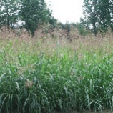
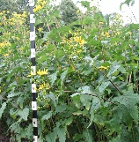
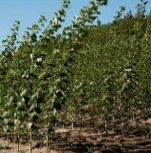
Promising energy crops (selection)
Energy crop | Soil pH | Annual precipitation, mm | Temperature, °С | Life cycle, years | Frequency of harvest | Biomass yield (Mg DM ha⁻¹ yr⁻¹)
Salix Viminalis L. | 5-7 | 650 -700 | 15-26 | 20-25 | 1 per 3 years | 6.2-11.3
Miscanthus x giganteus | 5.5 – 7.5 | 500-700 | 25-32, frost-resistant | 20 | annually | 15-20 (after 2nd year)
Panicum virgatum L. | 5.5-7 | 380-760 | drought-resistant | 10-15 | annually | 7-14
Columbian grass | 5-8.5 | 460-760 | drought-resistant | 8-10 | annually | 10-17
Silphium perfoliatum | 5.5-7.5 | Resistant to floods | 5-40, frost-resistant | 15-20 | annually | 15-20
Populus sp. L. | 6-7 | ≥600 | 15-25 | 20-25 | 1 per 2-3 years | 10-20 (after 3-4 years)
Notes:
Based on literature data and field trial results in Ukraine a comprehensive database of cellulosic biomass crops was developed. Some of the most promising crops are shown on this slide, like Miscanthus giganteus, Columbian grass, Cup plant, switchgrass and poplar with corresponding conditions suitable for their growing, as well as their life cycle, frequency of harvest and biomass yield.

Slide 6
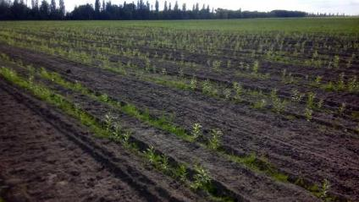
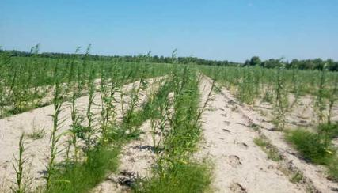
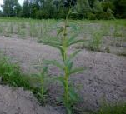
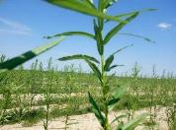
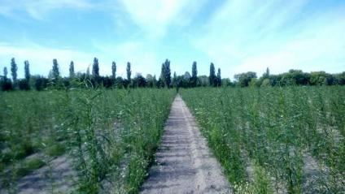
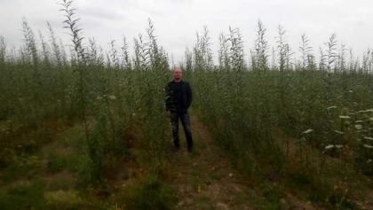
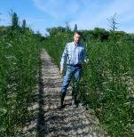
First year willow plantation, Kukhari
First month plantation
Second month plantation
Third month plantation
First year plantation
Three different high-yielding varieties of Salix viminalis L.: “Tora”, “Tordis”, “Inger”
Notes:
Analysis of field trials of Salix viminalis L. performed in different areas of Polissia region as well as in the case study area on a site of 50 ha showed good results for the high-yielding varieties of swiss selection: Tora, Tordis and Inger.
Here you can see some pictures of the first year willow growing. Being planted on May 2016 today (first year plantation) some plants reach 3.2 m high (with average high 2.6 m).

Slide 7
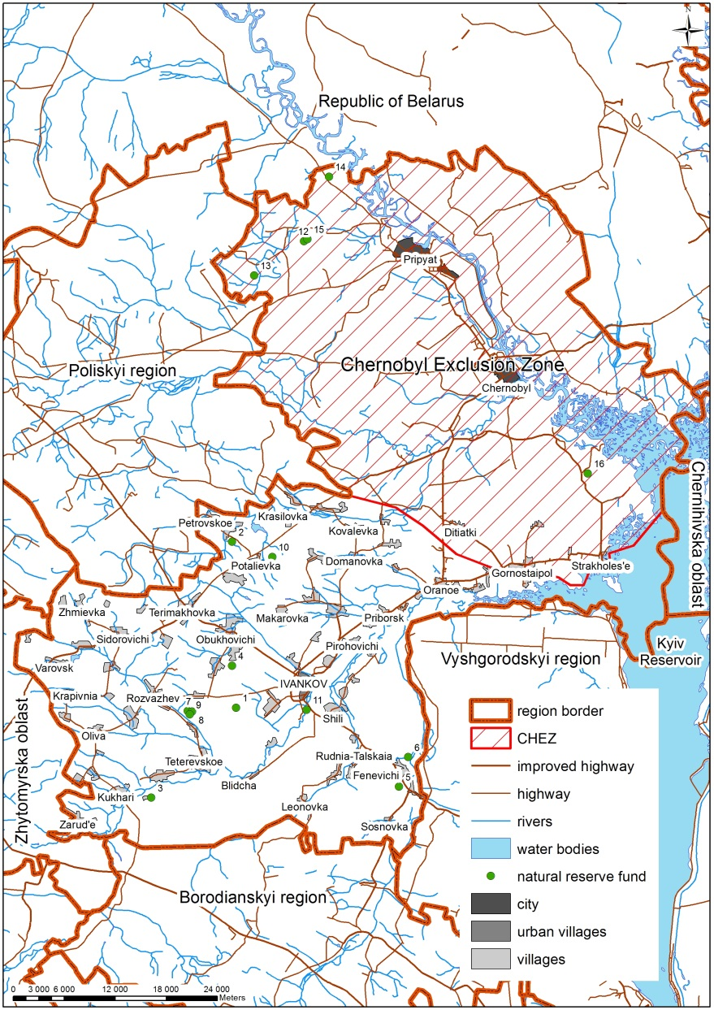
Ivankiv region land fund
Ivankiv region land fund structure (thousand hectares)
Total area | 361.6
Chornobyl exclusion zone | 181.9
Agricultural lands | 80.9
Arable lands (FAOSTAT) , including | 39.12
NON-Contaminated | 25.99
Contaminated | 13.12
Permanent crops | 0.9
Permanent meadows and pastures | 24.3
Underutilized agricultural land (free arable land + lay land) | 16.72
Forest, including | 78.28
Natural Forest or underutilized forest | 35.62
Managed Forest | 42.66
Other lands | 26.52
Urban areas | 7.2
Water fund land (wetlands) | 13.43
Other | 5.97
Notes:
Total area of Ivankiv region is 361.6 thousand ha, including 181.9 thousand ha of Chornobyl exclusion zone. Agricultural lands amount 80,9 th ha, including arable lands - ?? 51.2 th ha, although this data was specified by FAO – 39,12 th ha.
Other part of Ivankiv region has unfavourable socio-economic conditions. Before the Chernobyl nuclear power plant explosion the main employment sectors were the energy sector and animal husbandry (including milk production). Most of the agricultural enterprises were closed. The withdrawal of large areas of land from cultivation within the exclusion zone led to the intensification of agricultural production in the rest of Ivankiv region territory causing soil depletion and degradation.
Agricultural land covers only about 22% of Ivankiv region (Table 1). Only 17,600 hectares of arable lands were used in 2015 as the sown area by all categories of land users (agricultural enterprises, households).
Ivankiv region has the lowest indicators of agriculture production in Kyiv oblast: the share of the region in the grain crops production of the Kyiv oblast is only 0.24%, in the sunflower production 0.3%. The yield of grain crops is 2-3

Slide 8
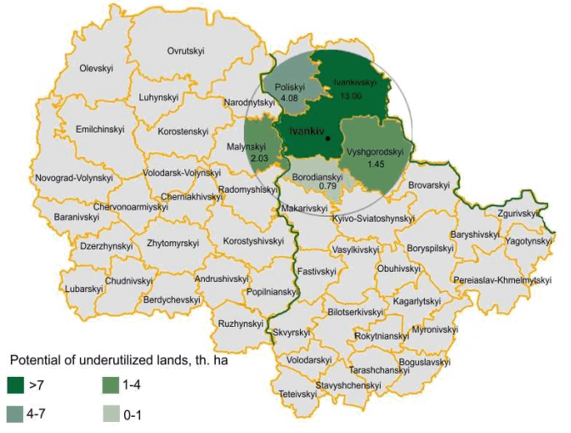
Underutilized land availability and potential for energy crops
Two categories of land are considered as underutilised in the assessment:
Abandoned agricultural land, i.e. land that is not needed any more for the production of food and feed crops or for other purposes;
Degraded or low productive land, i.e. land that is not suitable or no longer suitable for conventional commercial agriculture.
Regions | Distance* from Ivankiv town to the remotest points of the region, km | Underutilised land within 50 km zone, thousand ha
Ivankivskyi | 40 | 13.00
Poliskyi | 52 | 4.08
Malynskyi | 85 | 2.03 (part of the region)
Vyshgorodskyi | 55 | 1.45
Borodianskyi | 49 | 0.79
Potential in the regions located in 50 km radius from Ivankiv |  | 21.35
^{* Measured by roads}
Notes:
Two categories of land are considered as underutilized in the assessment:
Estimation of underutilized land was specified for the 50 km radius from the possible location of biofuel production plant, which is considered to be in Ivankiv town.
The distance was measured by roads from Ivankiv town to the remotest borders of adjoining regions: Vyshgorodskyi, Borodianskyi, Poliskyi and Malynskyi.
As you can see the transportation distance does not exceed 55 km (except Malynskyi region).
For these 5 above-mentioned regions the potential of the underutilized land within 50 km zone was assessed, with the biggest share for Ivankivskiy region – 13000 ha.
For the Malynskyi region only part of the underutilized lands was considered in the assessment.
The total potential in the regions located in 50 km radius from Ivankiv town amounts 21 350 ha of underutilized land.

Slide 9
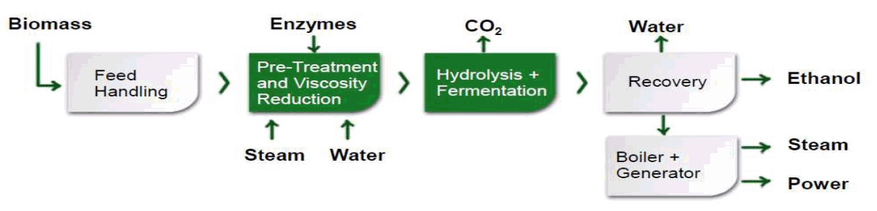
Value chain: Salix for 2G ethanol
Estimation of chips cost at plant gate (10 years)
Input data
Plant Capacity | 40,000 tons/year
Mean biomass productivity | 10 Mg DM ha⁻¹ yr⁻¹
Area needed for biomass production | 21,350 ha
Collection radius from the plant | 50 km
Annual potential of biomass feedstock | 200 Mg DM /year
Process flow diagram for
lignocellulosic ethanol production
Notes:
For the purpose of the techno-economic feasibility study, a scenario including a bioethanol plant in Ukraine has been hypothezised, with the following assumptions, as Lignocellulosic bioethanol technology for the Plant with Capacity of 40 000 tons per year that will be obtained from 200 th dry tons of willow biomass, grown on 21 350 ha of underutilized land with mean biomass productivity 10 dry tons/ha/yr.
Based on its previous experience with similar supply chains, Biochemtex with support of SecBio, has developed a cost model per dry ton of biomass.

Slide 10
Value chain: Salix for 2G ethanol
Estimation of chips cost at plant gate (10 years)
Costs | €/ha year | €/Mg DM year
Establishment of plantation | 123.4 | 12.34
Landowner fee | 13 | 1.3
Fertilization costs | 32 | 3.2
Harvesting (single pass for one row) | 32 | 3.2
Eradication of plantation | 15.7 | 1.57
Capital remuneration (2.5%) | 35 | 3.5
Biomass handling and transport (50 km) | 35 | 3.5
FINAL COST AT PLANT GATE |  | 28.7
Notes:
In the Technical and economic feasibility the period of 10 year for the industrial plantation was assumed for the cost model per dry ton of biomass feedstock at a plant gate.
Technical field cost will be 25.2 euro per dry ton and include landowner fee, fertilization costs, costs for harvesting, as well as amortization of installation (year 1) and eradication (year 10) costs with annual capital remuneration of 2.5% a year.
Biomass handling and transportation will add 3.5 euro /dry ton and the Final cost at a plant gate will be 28,7 euro/dry ton of willow chips.
The costs do not include irrigation fee and maintenance of an irrigation system, as no irrigation is envisaged for the case study site.
Also final cost do not include supply chain management.

Slide 11
Conclusions
Salix viminalis L. is the most suitable for growing in the climatic conditions of the Case study region according to literary analysis and review of field trials.
21,350 ha of underutilized agricultural land is available in 50 km radius from Ivankiv town, where potential biorefinery can be located.
Total final cost of willow chips delivered at a plant gate and collected within a 50 km radius is 28.7 Euro/dry ton.

Slide 12
THANK YOU !

