Slide 1
Sustainability assessment: Ukrainian Case Study
Marco Colangeli
Programme Adviser
Food and Agriculture Organization of the United Nations
Tuesday, 27 November 2018
FAO Headquarters
Rome, Italy

Slide 2
FULL results AVAILABLE: https://forbio-project.eu/documents
FORBIO

Slide 3
AIR QUALITY (GHG + NON-GHG Emissions)
In the baseline scenario the reference fuel used is petrol. The emission intensity of European petrol is 83.3 gCO2eq/MJ (Biograce, 2014).
The PROESA technology foresees the use of by- and co-products of the ethanol value chain and thus an allocation among the various products was performed (energy content).
The 16,720 ha available in the target area would be enough to produce some 33,440 tons of lignocellulosic ethanol and generate 87 GWh of electricity in excess to what is used in the processing stages.
Ethanol: 74 percent
Surplus electricity: 26 percent

Slide 4
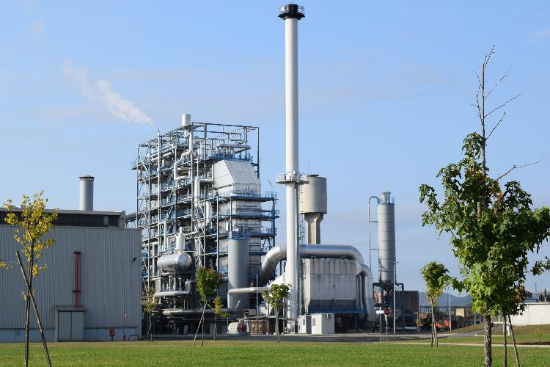
AIR QUALITY (GHG + NON-GHG Emissions)
Information related to processing stage are based on the model biorefinery of Crescentino, Italy.
This plant relies on off-site production of enzymes and yeast.

Slide 5
AIR QUALITY (GHG + NON-GHG Emissions)
Baseline: petrol
Emission intensity of petrol: 83.3 gCO₂eq/MJ (Source: BioGrace, 2014).
Target: lignocellulosic ethanol from willow
Emission intensity of lignocellulosic ethanol (allocated results): 36.10 gCO₂eq/MJ
Emission reduction compared to baseline: 56.67%
Avoided emissions: 42,319 tons CO₂eq per year
On-site enzymes production would diminish of a further 22.4 gCO₂eq/MJ the carbon intensity of the bioethanol, resulting in a reduction of about 83% when compared to baseline.

Slide 6
AIR QUALITY (GHG + NON-GHG Emissions)

Slide 7
SOIL QUALITY
In baseline conditions, the area is covered by grasslands and these systems in low productivity, marginal areas tend to be in equilibrium in terms of SOC.
The target scenario foresees the cultivation of willow, a perennial deciduous tree crop which is harvested in winter, when the plants have shed their leaves.
In this scenario no organic fertilization (e.g. manure) is performed and thus the SOC balance is only affected by the natural removal and the inputs from the debris represented by the above and below ground biomass.
It was estimated that willow cultivation returns about 5,600 kg of biomass (mostly leaves and chips from the harvesting operation) per ha are left in the field at every harvest, which equals to some 1,867 kg per year. In total, the system has the potential to accumulate up to 314 kg of SOM per ha each year.

Slide 8
LAND TENURE
Sustainability risks exist for this indicator in the case of Ukraine. The land tenure structure of the target area is rather complex and still under development.
After the collapse of the former USSR, agriculture in Ukraine has been dominated by large extension of land owned by private entities, mainly agri-holdings.
Large surfaces of less productive and wanted land remained property of the central government and are normally given under concession through a system of permits. The structure of tenure rights is not dynamic and permits are issued by the government with a special procedure.
The aforementioned complexity highlighted the risk in Ukraine that marginal lands of interest for the production of biomass may remain underutilized because of the difficulties for small farmers to i. obtain a permit; or ii. to be identified as the land owner.

Slide 9
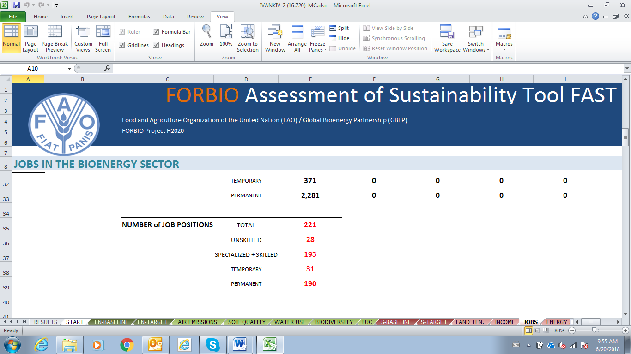
JOBS IN THE BIOENERGY SECTOR
Notes:
Due to the presence of large scale farms and high mechanization of the SRC production cycle, very few jobs in the agricultural stages of the value chain

Slide 10
INCOME
According to the Deliverable 2.6 (techno-economic assessment), production cost of willow SRC in the case study location is EUR 28.7 per ton of biomass delivered at the biorefinery gate. Biomass transport costs represent a contribution of EUR 3.5/t. Considering an average yield of 10 t ha-1 yr-1, the landowner fee was calculated at EUR 1.3/t or EUR 13/ha.
Assuming that all field operations are carried out by third party actors, the income for an average farm (90 ha) owner in the Ivankiev Region would be EUR 1,170/year.

Slide 11
PRODUCTIVITY
This indicator includes several aspects: biomass yield, fuel yield, production cost.
The estimate of production cost was performed through a number of calculations and data obtained both from direct communication with Biochemtex and information found in the specialized literature.
CAPEX:
EUR 125,000,000 for a 33,440 t/year biorefinery (Crescentino, Italy)
OPEX
Feedstock expenditure: EUR 4,681,000 per year
Enzymes, yeast, catalysts, other inputs: EUR EUR 10,790,000 per year (E4tech, 2017)
Salaries: EUR 2,952,000 per year
Miscellaneous: EUR 1,200,000 per year

Slide 12
PRODUCTIVITY
In total the production cost of lignocellulosic ethanol was calculated to be EUR 720 per ton.
This value calculated in the real case scenario of FORBIO was compared to values found in literature. According to E4TECH (2017), lignocellulosic ethanol production costs in Europe range between EUR 940 and 1,010 per ton.

Slide 13
GROSS VALUE ADDED
At current market prices, sales of ethanol would generate some 17,835,600 EUR/year.
At the current price of electricity for large scale biomass-fueled power plants of EUR 123.9/MWh as per Article 20 of Law "On Heat Energy Supply”, (2018) revenues for the generation of 87 GWh of renewable electricity would account to EUR 10,779,300 per year for the next 20 years.
The generation of heat to serve 28,030 households in the country would deliver additional EUR 4,905,252/year
Total revenues for a 33,400 t/year biorefinery at current market conditions would then be EUR 33,520,000 per year.

Slide 14
GROSS VALUE ADDED
Being, the total production cost of lignocellulosic ethanol in Ukraine would be 720 EUR/t or 24,048,000 EUR/year
Thus, given the current market conditions, the Gross Value Added of a second generation biorefinery would be positive by some EUR 9,457,000 per year
Ethanol price volatility though is a key parameter but in this case the favourable market and incentive conditions for electricity and heat generated make the GVA of this advanced biofuel value chain sustainable.

Slide 15
Thank you

