Slide 1

Tracking Sustainable Development of Bioenergy
Dr. Maria Michela Morese
FORBIO Project Coordinator
GBEP Executive Secretary
Food and Agriculture Organization of the United Nations (FAO)

Slide 2
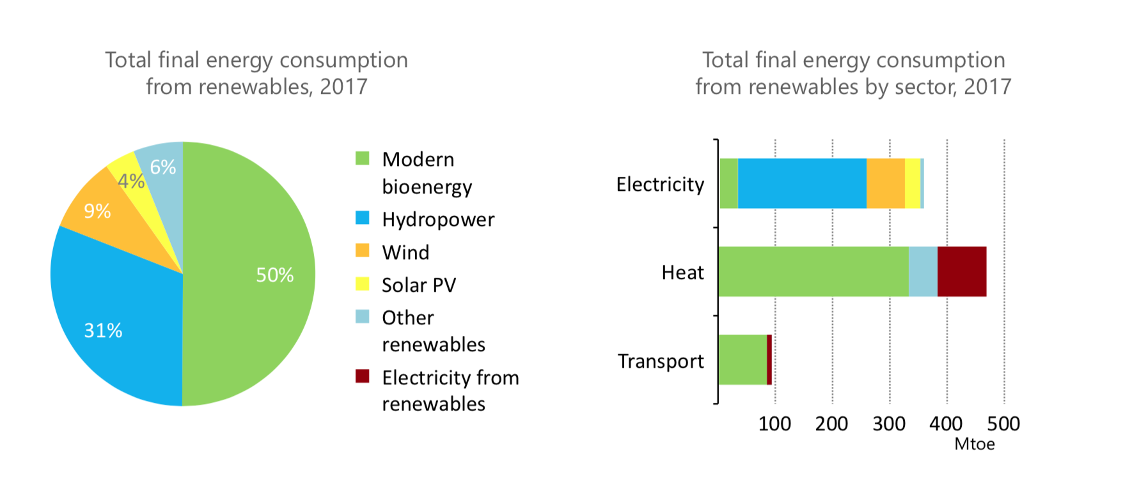
Contribution of modern bioenergy: the overlooked giant of renewables
Modern bioenergy is the only renewable source that can provide electricity, direct heat and transport fuels.
Source: IEA 2017

Slide 3
SUSTAINABILITY is key
Bioenergy presents excellent OPPORTUNITIES
not without CHALLENGES.
SUSTAINABILITY IS KEY to take out the best of opportunities.
The Global Bioenergy Partnership (GBEP)
has developed the most widely recognized and agreed set of
indicators for the assessment and monitoring of bioenergy sustainability.

Slide 4
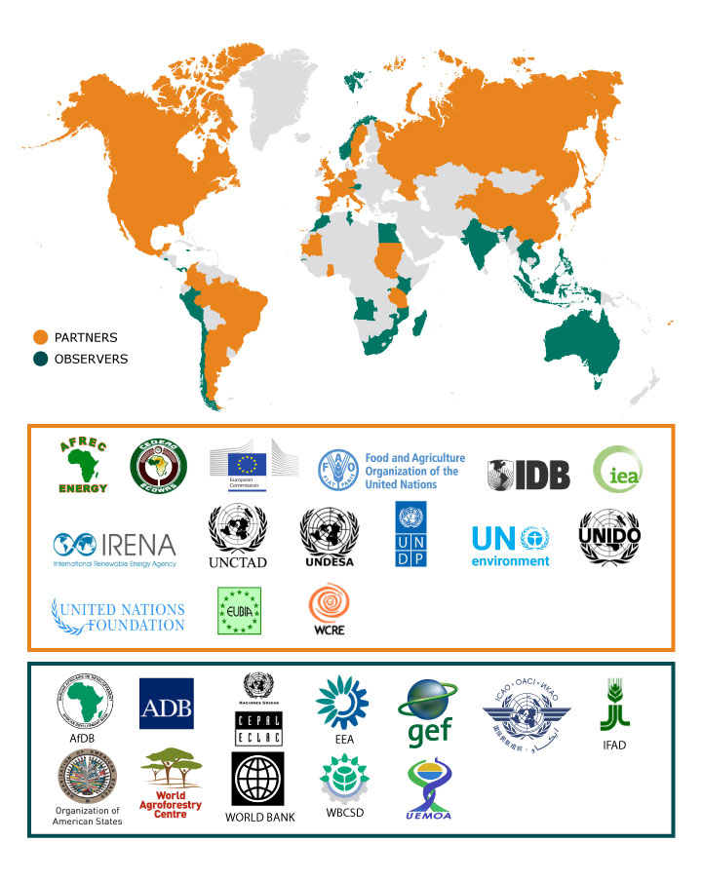
The Global Bioenergy Partnership (GBEP)
GBEP was established to implement the commitments taken by the G8 in 2005.
GBEP reports every year to the G7 and G20, and receives regular mandates from them.
Italy and Brazil are currently Chair and co-Chair of the Partnership. The Secretariat is hosted at FAO in Rome.
38 Partners and 41 Observers
(Governments and International Organizations)

Slide 5
GBEP sustainability indicators for all types of bioenergy
GBEP has developed a set of 24 indicators for the assessment and monitoring of bioenergy sustainability at national level
The GBEP indicators cover each of the three pillars of sustainability and address the production and use of all liquid, solid and gaseous biofuels for heating and cooking, electrification and transport
ENVIRONMENTAL SOCIAL ECONOMIC
Notes:
These indicators and the respective methodology sheets, which address the production and use of all forms of bioenergy, are intended to guide any analysis of bioenergy undertaken at the domestic level with a view to informing decision making and facilitating the sustainable development of bioenergy.
Measured over time, the indicators will show progress towards or away from a sustainable development path, as determined nationally.
Most widely recognized tool as its agreement involved all our members.
Three pillars – equal importance.

Slide 6
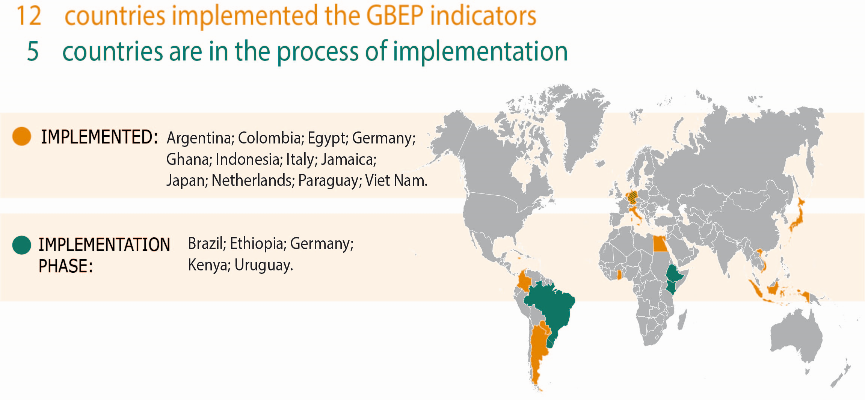
Implementation of the
sustainability indicators

Slide 7
GBEP indicators used as starting point for the FORBIO project
The GBEP methodologies were adapted to the FORBIO context:
EX-POST, National Level tool (GBEP) → EX-ANTE, Local Level Tool (FORBIO)
The adapted version of the Indicators in FORBIO returned a number of valuable information for the market uptake of advanced biofuels in EU and neighboring countries:
  In all three countries, environmental conditions (air quality, soil quality, water quality, biodiversity) improve with the presence of advanced biofuel value chains
  In all three countries, the advanced biofuel value chains tested have positive impacts on social aspects (e.g. employment, income, access to energy, etc.)
  In Italy and Germany, economic sustainability represents a bottleneck to the market uptake of advanced biofuels whereas in Ukraine, at current conditions, economic sustainability of a 2G ethanol plant would be obtained
Added value of this project - New approach: sustainability assessment + roadmap to be used by policy makers to remove identified barriers.
Notes:
Feedstock production costs in Ukraine are much more competitive than in Italy (due to cost of labour and landowner fees)
In addition, Ukraine's current incentive system for renewable electricity and heat generation are also much more competitive than in Italy
The two aspects above shift the net economic breakeven point in favor of the Ukrainian case study site, where lignocellulosic ethanol could be economically profitable.

Slide 8

Bioenergy contributing to NDCs and SDGs
Countries’ pledged contributions to global emission reduction are set out in their Nationally Determined Contributions (NDCs).
Bioenergy could contribute achieving these objectives both in terms of mitigation and adaptation.

Slide 9
Working together to foster sustainable bioenergy
Bioenergy needs a new impetus
Collaboration amongst international initiatives and organizations is key to join forces → H2020 and other EU-funding mechanisms used to develop R&I projects through the use of the GBEP tools and activities
Develop good projects → inform policy makers
Stable and good policies could accelerate investments and the contribution of bioenergy to sustainable development

Slide 10
Key messages
Bioenergy offers opportunities to the agriculture and forestry sectors
Sustainability is key
Monitoring sustainability is a necessary step in order to understand, evaluate and improve the performances of the sector
GBEP is actively working on the diffusion of sustainability in the processes of production and use of bioenergy resources with several activities and tools, including the GBEP Sustainability Indicators for Bioenergy (GSIs)
GBEP and the GSIs play a key role to help develop sustainable supply chains, implement appropriate sustainability governance, and support policymaking while facilitating an harmonization of policies.
Bioenergy needs a new impetus based on up-to-date evidence, more emphasis on sustainability and stable policies that would stimulate investments.

Slide 11
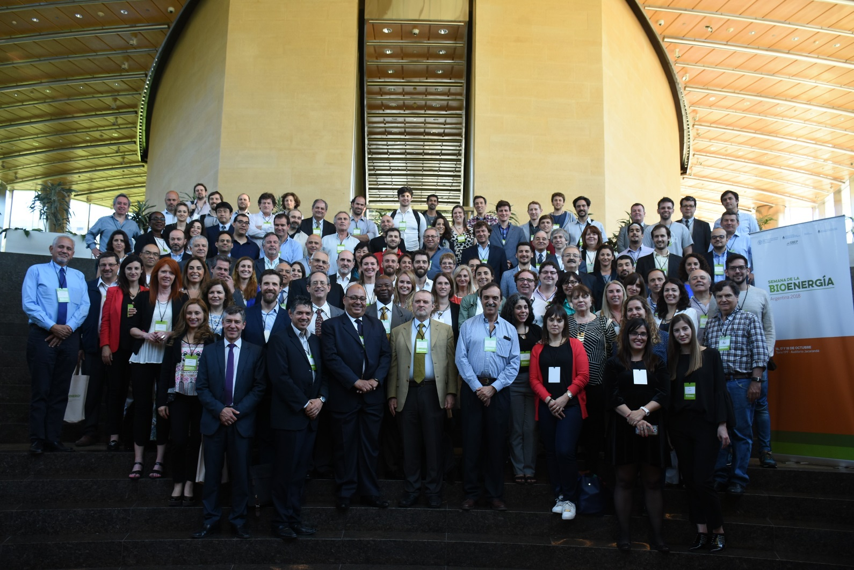
Thank you
GBEP-Secretariat@fao.org
http://www.globalbioenergy.org

