Slide 1
Fostering sustainable feedstock production for advanced biofuels on underutilised land in Europe
Rainer Janssen, Rita Mergner
WIP Renewable Energies
Sylvensteinstr. 2
81369 Munich
www.wip-munich.de
Peter Gyuris, Ömer Ceylan
GEONARDO
Zahony utca 7
H-1031 Budapest
www.geonardo.com
This project has received funding from the European Union's Horizon 2020
research and innovation programme under grant agreement No691846.

Slide 2
Project consortium
WIP – Renewable Energies
Partner contact name: Rainer Janssen, Rita Mergner, Dominik Rutz
Food and Agriculture Organization of the United Nations
Partner contact name: Marco Colangeli
Geonardo Environmental Technologies Ltd.
Partner contact name: Ömer Ceylan, Peter Gyuris
Consiglio per la Ricerca in Agricoltura e l’Analisi dell’Economia Agraria
Partner contact name: Guido Bonati
Biochemtex Spa
Partner contact name: Mariella Mule
Blacksmith Initiative - UK
Partner contact name: Valeriia Kovach
Scientific Engineering Centre „Biomass” Ltd.
Partner contact name: Olha Haidai
Center for Promotion of Clean and Efficient Energy
Partner contact name: Nicoleta Ion
Forschungsinstitut für Bergbaufolgelandschaften e.V.
Partner contact name: Dirk Knoche, Raul Köhler
Polish Biomass Association
Partner contact name: Maria Smietanka, Magdalena Rogulska
European Landowners’ Organization
Partner contact name: Marie-Alice Budniok
University of Limerick
Partner contact name: JJ Leahy

Slide 3
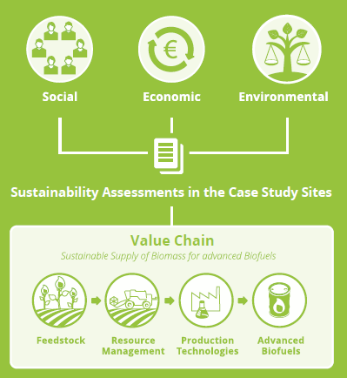
Project idea
Assess the viability of using underutilised land (contaminated, abandoned, marginal, fallow land etc.) for sustainable bioenergy feedstock production
Develop a strategy for building up competetive and sustainable local supply chains
No effect on the supply of food and feed
No interference with land used for recreational and conservation purposes

Slide 4
Objectives
Identify social, economic, environmental and governance-related opportunities and challenges
Evaluate agronomic and techno-economic potential of the selected bioenergy value chains
Assess environmental, social and economic sustainability
Analyse economic and non-economic barriers to the market uptake
Develop strategies to remove the barriers
Encourage European farmers to produce sustainable biomass feedstock
Build capacity of stakeholders for setting up sustainable bioenergy supply chains

Slide 5
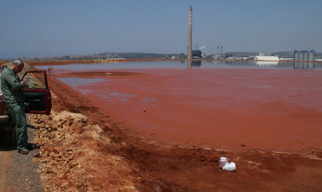
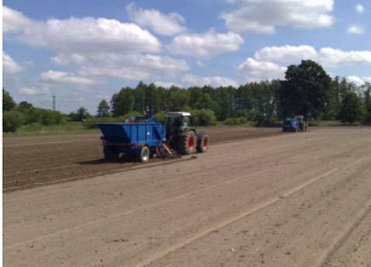
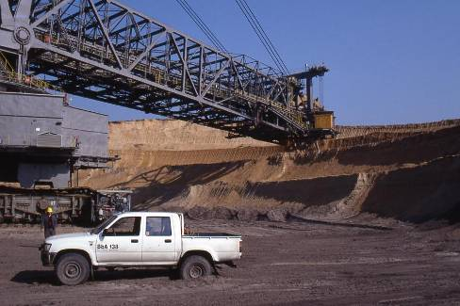
Selected case studies
CASE 1
ITALY
Sulcis, Portoscuso
Contaminated land from
industrial activities
22,000 ha
CASE 2
UKRAINE
South of Kiev
Underutilised marginal agricultural land
10,000 ha
CASE 3
GERMANY
Metropolis region
Berlin & Brandenburg
Lignite mining & sewage irrigation fields
25,000 ha
Outreach countries: Romania, Poland, Hungary, UK and Ireland

Slide 6
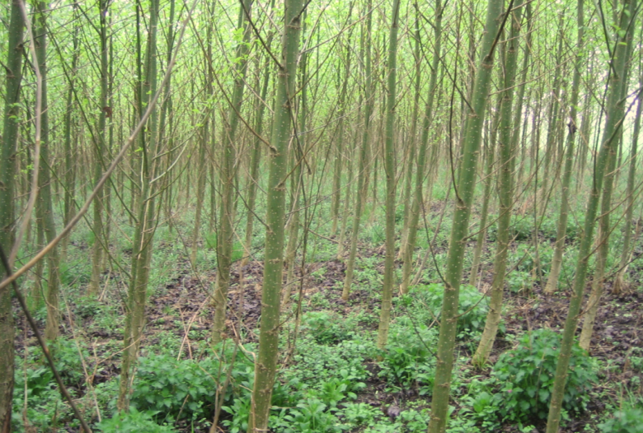
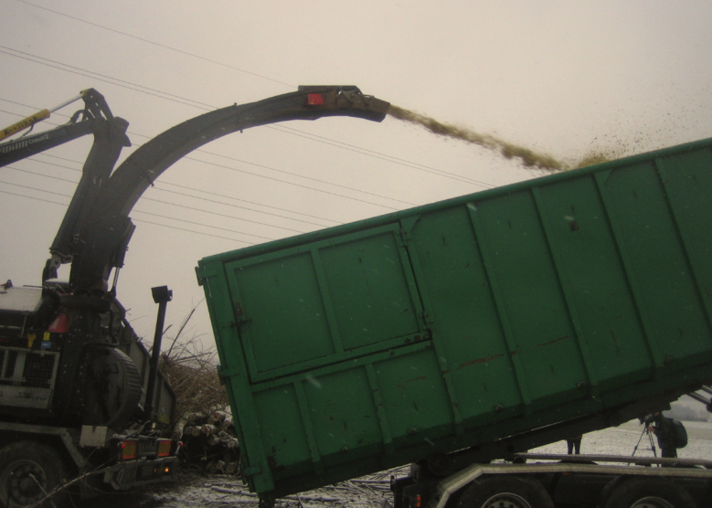
Sustainability
Reference tool: GBEP Sustainability Indicators for Bioenergy
Development of a tailored set of sustainability indicators for bioenergy based on the specific conditions of each of the case study sites
Compilation of existing environmental, social and economic data and data gaps analysis
Measurement of the set of sustainability indicators for bioenergy in the case study sites

Slide 7
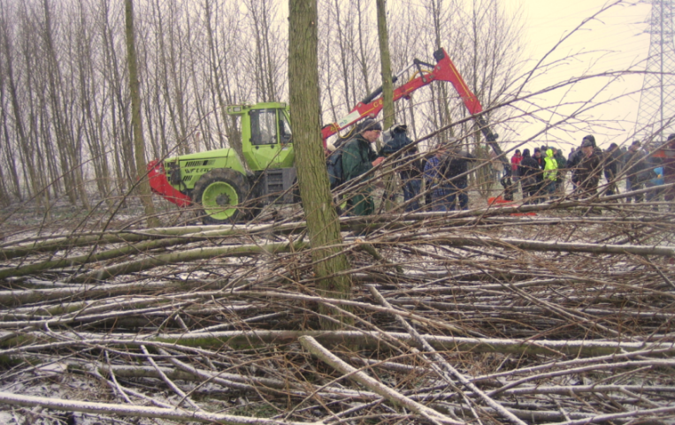
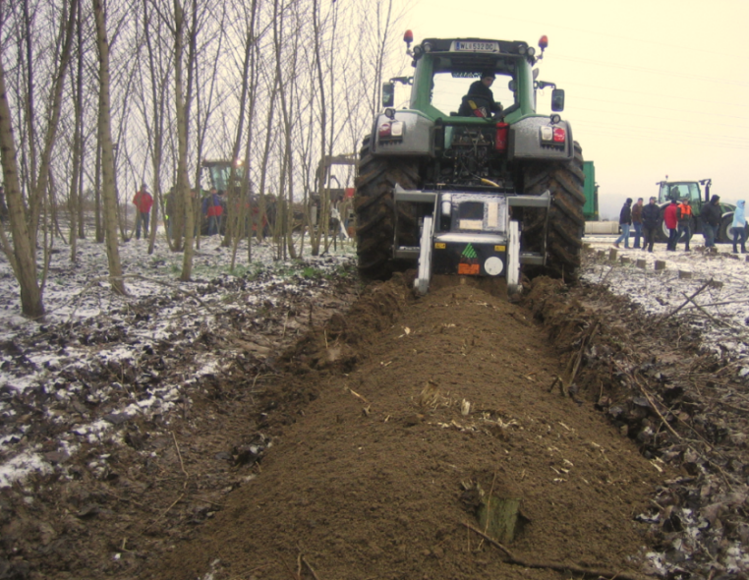
Challenges
Reliable data on underutilised lands
Little awareness regarding the advantages of using underutilised lands for RES projects
Lack of local strategies regarding RES development and valorization of underutilised lands
Legal and administrative procedures for getting necessary permits
Available investments for new projects

Slide 8
Added value of FORBIO
Data collection via agronomic and techno-economic feasibility studies in Italy, Germany and Ukraine (Agronomic reports available by December 2016)
Sustainability assessments
Knowledge transfer, capacity building actions (trainings, study tours, webinars)
Roadmaps for the removal of the main economic and non-economic barriers
Sharing best practices which allow the most sustainable and energy efficient use bio-resources
Mainstreaming new opportunities on the local level

Slide 9
Results so far in FORBIO
Preparation of Agronomic Feasibility Study for Italy
Preparation of Agronomic Feasibility Study for Germany
Preparation of Agronomic Feasibility Study for Ukraine
Preparation of Technical and Economic Feasibility Study for Italy
Report on best practices for bioenergy policy, regulations and support schemes
Preparation of dissemination and informational materials, participation in related events and stakeholder consultation
Online media presence, Web2.0, social media activity

Slide 10
Project meetings in FORBIO
Kick-Off meeting in Budapest, Hungary (14-15 January 2016)
Stakeholder and project meeting in Sardinia, Italy (12-14 October 2016)
Project meeting in Münich, Germany (10-11 April 2017)
Project meeting, stakeholder info day and study tour in Finsterwalde, Germany (5-7 September 2017)
Project workshop and info-day in the study area in Kiev, Ukraine (19-21 September 2017)

Slide 11
Main FORBIO dissemination events
GBEP 4th Bioenergy Week in Budapest, Hungary attended by FAO and ENERO (22 June 2016)
4th BioEconomy Stakeholders’ Conference in Utrecht, the Netherlands attended by WIP (12-13 April 2016)
BioSTEP Stakeholder Workshop in Utrecht, the Netherlands attended by WIP (14 April 2016)
Forum for the Future of Agriculture 2017 in Brussels, Belgium, organised by ELO (28 March 2017)
European Geosciences Union General Assembly 2017 in Vienna, Austria attended by WIP (23 April 2017)
European Biomass Conference and Exhibition in Stockholm, Sweden to be attended by WIP (25 June 2017)

Slide 12
Thank you for your attention!
www.forbio-project.eu
Rainer Janssen, Rita Mergner
WIP Renewable Energies
Sylvensteinstr. 2
81369 Munich
www.wip-munich.de
Peter Gyuris, Ömer Ceylan
GEONARDO
Zahony utca 7
H-1031 Budapest
www.geonardo.com
This project has received funding from the European Union's Horizon 2020
research and innovation programme under grant agreement No691846.
This power point presentation reflects only the author’s view and the Innovation and Networks Executive Agency (INEA) of the European Commission is not responsible for any use that may be made of the information it contains.

