Slide 1

WP3: Sustainability assessment of selected advanced bioenergy pathways in the case study sites
FORBIO Project meeting, Munich Germany
Marco Colangeli and Lorenzo Traverso (FAO)
10 March 2017

Slide 2
The Selected Sustainability Indicators for Bioenergy in the context of FORBIO
FORBIO BIOENERGY SUSTAINABILITY INDICATORS
ENVIRONMENTAL | SOCIAL | ECONOMIC
Life-cycle GHG | Land Tenure | Productivity
Soil Quality | Change in Income | Net Energy Balance
Non GHGs | Jobs in Bioenergy Sectors | Gross Value Added
Water Use and Efficiency | Modern Energy Access | Trainings
Water Quality |  | Infrastructures and logistics for bioenergy distribution
Biodiversity
Land Use Change |  | Capacity and Flexibility of use of bioenergy

Slide 3
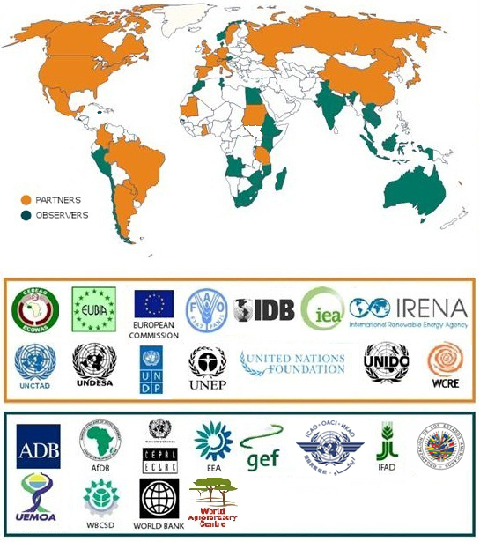
GBEP MEMBERSHIP

Slide 4
GBEP SUSTAINABILITY INDICATORS
FOR BIOENERGY
GBEP has developed a set of 24 indicators for the assessment and monitoring of bioenergy sustainability at national level
The GBEP indicators cover each of the three pillars of sustainability and address the production and use of all liquid, solid and gaseous biofuels for heating and cooking, electrification and transport
ENVIRONMENTAL SOCIAL ECONOMIC

Slide 5
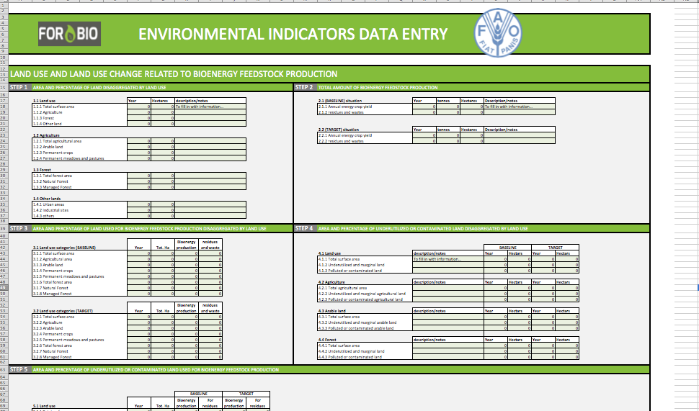
Compilation of existing data
In order to perform the sustainability assessment FAO has put together a comprehensive set of data entry sheets for each of the Environmental indicators; Data entry sheets for Social and Economic indicators will be circulated by the end of April.
Existing environmental, social and techno-economic data will be screened and collected, necessary missing information will be researched and, to the extent possible, surveyed and produced in the form of primary data;

Slide 6
Identification of data gaps and relatex proxies
The analysis of the sustainability of bioenergy requires often long term data series or specific technical data and it is possible that such information is not available for each tailored indicator

Slide 7
The TARGET AREA
The indicators refer to operations and the impacts of these operations are calculated with regard to a specific area which is defined as the target area.
“The target area is the smallest surface of land as defined by subnational boundaries of A) physical, B) political; C) cultural origin, that is interested by the bioenergy production and use operation.”

Slide 8
The TARGET AREA
In the case of a hypothetical production of bioenergy feedstock on contaminated soils, as in FORBIO, the target area will be the smallest among A) the area of the watershed(s) in which the operation takes place; and/or B) the area of the municipalities touched upon/interested by the bioenergy production operation; and/or C) the area as defined by cultural heritage (e.g. regions or zones) that is touched upon/interested by the bioenergy production operation.
The target area should be defined and explicitly discussed with local stakeholders in order to find consensus on its size and coverage, location and boundaries.

Slide 9
FAST
FORBIO ASSESSMENT of SUSTAINABILITY TOOL
A user-friendly calculator built upon an adapted version of the GBEP sustainability indicators
Neither an official project deliverable nor an FAO pre-existing tool
An expedite way to measure the sustainability indicators in FORBIO

Slide 10
BASELINE SHEETS
The baseline sheets are filled out to describe the initial situation of the case study sites thanks to:
Environmental aspects (e.g total surface, land use, etc.)
Social aspects (e.g. land tenure, employment, etc.)
Economic aspects (e.g. GDP, access to roads, size of the fleet, etc.)
BASELINE SHEETS
ACCURATE SITE
CHARACTERIZATION
DATA

Slide 11
TARGET SHEETS
The target sheets are filled out with data related to the proposed value chains:
Environmental aspects (e.g type of crops, fstk processing, fstk transport, etc.)
Social aspects (e.g. land tenure, employment, etc.)
Economic aspects (e.g. ethanol cost per tonne, salaries, etc.)
TARGET SHEETS
STEP BY STEP
VALUE CHAIN
DEFINITION
DATA

